Slide 1

School-wide Positive Behavior Interventions and Supports:
What paraprofessionals have asked.

Slide 2

Activity/ Discussion
Where are we now?

Slide 3
Why School Wide Positive Behavior Interventions & Supports?
Decrease the likelihood of new problem behaviors starting.
Helps keep existing problem behaviors from getting worse.
Change the school environment to reduce or eliminate things that cause the behaviors to occur.
Teach, monitor, & reinforce appropriate social behavior to increase the likelihood it will continue.
Create a calm and predictable school environment for students and staff.
Adapted form www.pbis.org
Notes:
Basis is applied behavior analysis.
Presently being implemented in over 18,000 schools.

Slide 4
FYI: all these mean the same thing
PBS=Positive Behavior Supports
PBIS=Positive Behavior Intervention & Supports
SWPBS=School-wide Positive Behavior Supports
SW-PBIS=School-wide Positive Behavior Interventions & Supports
Others?
Notes:
Sharon

Slide 5
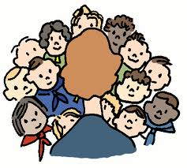
By being part of the process, you can help……….
Increased attendance
Increased positive social interactions between staff and students
Increased learning (test scores)
Increased graduation rate
Increased teacher retention
Improve school efficiency
Increased administrative time
Perception of increased teacher effectiveness
Increased instructional time
Decreased truancy
Decreased bullying
Decreased drop-out rate
Decrease Office Discipline Referrals
Proactive, preventative measure for suicide
Adapted from Rob Horner, Nov 2012. Northwest PBIS Coaching Conference Keynote
Notes:
Behavioral health staff could share this with parents. Helps to gain an understanding of the short and long term positive effects.

Slide 6

Most often asked questions from paraprofessionals!
“What is it?” (PBIS)
Framework? HUH?
Is this special education?
“Why are we teaching this? They already know this stuff!”
“Why are we doing this?”
“What is my role?”
Others to add?

Slide 7
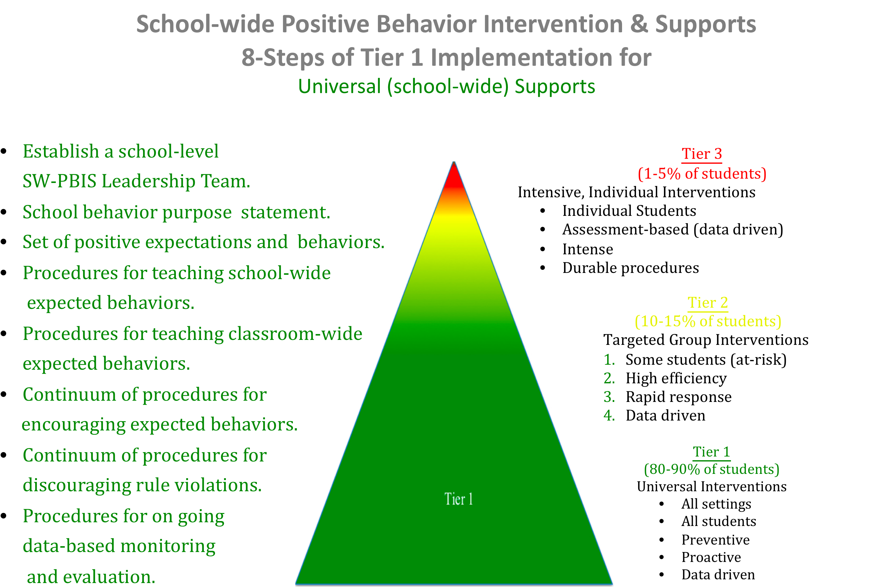
Few students
Some students
All students
Notes:
Handout

Slide 8
Installation: the beginning of a unified approach to collecting data, teaching behavior expectations, and implementing the reward systems.
Common Language
MEMBERSHIP
Common Experience
Common Vision/Values
www.pbis.org

Slide 9
Implementation Steps: Step 1 of “8 Steps”
Establish a school-level PBIS Leadership Team
School-behavior purpose statement
Set of positive expectations and behaviors.
Procedures for teaching school-wide expected behaviors
Procedures for teaching classroom wide expected behaviors.
Continuum of procedures for encouraging expected behaviors.
Continuum of procedures for discouraging rule violations.
Procedures for on-going data-based monitoring and evaluation.
www.pbis.org
Notes:
Lori
Student success is achieved through appropriate modeling by adults
Teaching missed social skills through structured environment, repetiion, positive and negative reinforcement
Establish a school-level PBIS Leadership Team
Teams must realize that they are a leadership team and have the ability to make positive changes in the school. Plan for professional development and technical assistance.
Have roles & responsibilities.
Meet 1-2 times per month.
Establishing a Foundation for Collaboration and Operation – PBIS requires some systems change efforts.
Administration, teachers, paraprofessionals, counselor, mental health, community
2. School-behavior purpose statement
3. Set of positive expectations and behaviors.
Term used to organize the specific social behaviors that are desired or expected in different settings across the school day. (ex. Be safe, be kind, be responsible)
4. Procedures for teaching school-wide expected behaviors
Teachers will prepare lesson plans (models available) to teach the behavior expectations for the non-structured selected settings. Writing lesson plans in a small group and sharing is encouraged. Want all teaching to give the same message.
Teach what the behavior looks like in each setting (replacement behavior)
5. Procedures for teaching classroom wide expected behaviors.
How to make teaching the social skills prior your education curriculum. (refer to matrix for necessary behaviors for classroom instruction)
6. Continuum of procedures for encouraging expected behaviors.
Increase the liklihood the replacement behavior will be used when taught
7. Continuum of procedures for discouraging rule violations.
At minimum verbal praise up to a school-wide reward system for appropriate behaviors
8. Procedures for on-going data-based monitoring and evaluation.
What happens when a student mis-bahves. Setting up a consistent set of rules, definitions, and consequences for behavior problems.

Slide 10

Step 1: School-wide Leadership Team
Role of the Leadership Team
PBIS Leadership Team for each school

Slide 11
Implementation Steps: Step 2 of “8 Steps”
Establish a school-level PBIS Leadership Team
School-behavior purpose statement
Set of positive expectations and behaviors.
Procedures for teaching school-wide expected behaviors
Procedures for teaching classroom wide expected behaviors.
Continuum of procedures for encouraging expected behaviors.
Continuum of procedures for discouraging rule violations.
Procedures for on-going data-based monitoring and evaluation.

Slide 12
Step 2: Behavior Purpose Statement
Insert school Behavior Purpose Statement

Slide 13
Implementation Steps: Step 3 of “8 Steps”
Establish a school-level PBIS Leadership Team
School-behavior purpose statement
Set of positive expectations and behaviors.
Procedures for teaching school-wide expected behaviors
Procedures for teaching classroom wide expected behaviors.
Continuum of procedures for encouraging expected behaviors.
Continuum of procedures for discouraging rule violations.
Procedures for on-going data-based monitoring and evaluation.
Notes:
School wide reward system for reinforcing the use of desired social behaviors

Slide 14
Step 3: (School Name) Behavior Matrix
You chose 3 Behavioral Expectations
    Be Respectful
    Be Responsible
    Be Safe
  The matrix spells out how each looks in your non-structured settings (and in the classroom) for all adults and students.

Slide 15
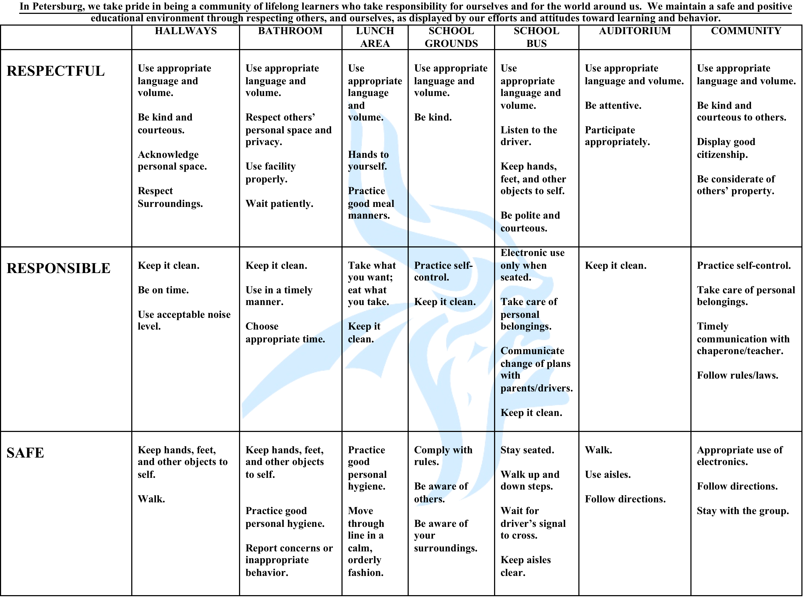
Behavior Purpose Statement
Non structured locations
Behavior Expectations
Behavior Definitions
Notes:
Added “Be” to beginning of respectful, responsible, safe.

Slide 16
Insert school matrix

Slide 17
Implementation Steps: Step 4 of “8 Steps”
Establish a school-level PBIS Leadership Team
School-behavior purpose statement
Set of positive expectations and behaviors.
Procedures for teaching school-wide expected behaviors
Procedures for teaching classroom wide expected behaviors.
Continuum of procedures for encouraging expected behaviors.
Continuum of procedures for discouraging rule violations.
Procedures for on-going data-based monitoring and evaluation.
Notes:
School wide reward system for reinforcing the use of desired social behaviors

Slide 18
Step 4: Classroom Lesson Plans for non-structured: Para’s role.
Teaching students the expected behaviors in the classroom.
  Most likely the classroom teacher will lead lesson, but you may be asked to assist
  Be in classroom to hear lesson.
  Review/reinforce in natural settings.
Notes:
Other lessons: community events, etc

Slide 19
Supporting formal lessons taught in classrooms.
Re-teaching
  Scheduled booster sessions.
  Teach before special activities or activities know to create problems.
  Teach/support in natural environments.
  Review/remind students of behavior definitions and expected behaviors.
  When there is unexpected behavior in the school.
    How does this look? Role-play and questions you can use
Model the expected behaviors
TEACHING=Tell+Show+Practice+Feedback+Re-teach
KEY: Tie it back to the 3 behavioral expectations and the matrix

Slide 20
Implementation Steps: Step 5 of “8 Steps”
Establish a school-level PBIS Leadership Team
School-behavior purpose statement
Set of positive expectations and behaviors.
Procedures for teaching school-wide expected behaviors
Procedures for teaching classroom wide expected behaviors.
Continuum of procedures for encouraging expected behaviors.
Continuum of procedures for discouraging rule violations.
Procedures for on-going data-based monitoring and evaluation.

Slide 21
Classroom matrix: Step 5 of “8 Steps”
Coming to a school near you in 2013-2014!
Notes:
How does it work in elementary

Slide 22
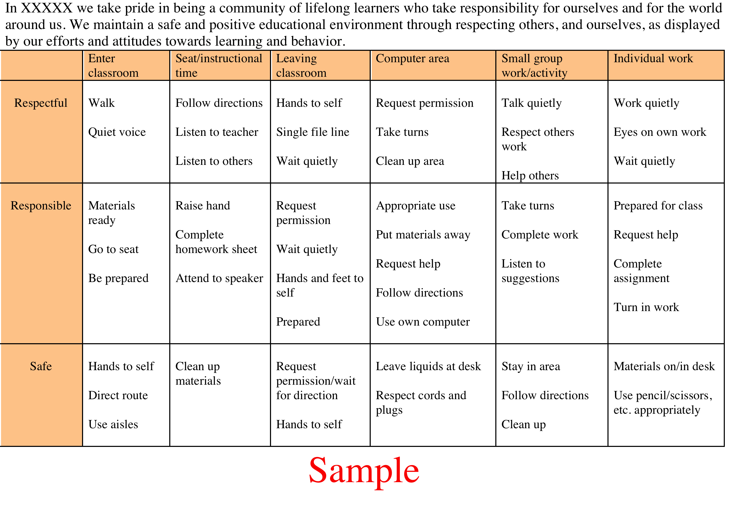

Slide 23
Implementation Steps: Step 6 of “8 Steps”
Establish a school-level PBIS Leadership Team
School-behavior purpose statement
Set of positive expectations and behaviors.
Procedures for teaching school-wide expected behaviors
Procedures for teaching classroom wide expected behaviors.
Continuum of procedures for encouraging expected behaviors.
Continuum of procedures for discouraging rule violations.
Procedures for on-going data-based monitoring and evaluation.
Notes:
School wide reward system for reinforcing the use of desired social behaviors

Slide 24

Reward the “behavior” not the “person”
  Not good: “you are selected as student of the week, congratulations?
  Good: “You were working hard, on-task and quiet during independent seat work…that is respectful of others trying to get their work done… nice job.”

Slide 25

Verbal praise (cont.)
Not clear praise: “pizza party for no referrals”.
Discussion: Good Praise?
  MOST OF ALL….Be sincere!

Slide 26
Activity: small groups
Create a list of positive things to say!

Slide 27
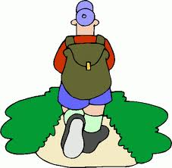

Why a tangible system?
Tied into school expectations
Specific feedback on student’s behavior
Provides visible acknowledge of appropriate behavior for student
Helps to remind staff to provide acknowledgements

Slide 28

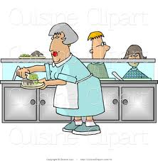
Step 6: Encouraging Expected Behaviors/Reward System
              Each grade level has a reward system in place
                K-5: ticket system
                6-8: Learning Earnings/Post card
                9-12: Post Card/ Drawings
                ALL: Verbal Praise and Thanks
Any staff person can give out rewards or positive recognition
  Make sure to tie it to the 3 behavioral expectations
  How does this look? Role-play
    (Elem, Middle, High)

Slide 29
Elementary School-wide Reward Systems
Insert school photos

Slide 30
Middle School & High School School-wide
Reward System
Insert school photos

Slide 31
Implementation Steps: Step 7 of “8 Steps”
Establish a school-level PBIS Leadership Team
School-behavior purpose statement
Set of positive expectations and behaviors.
Procedures for teaching school-wide expected behaviors
Procedures for teaching classroom wide expected behaviors.
Continuum of procedures for encouraging expected behaviors.
Continuum of procedures for discouraging rule violations.
Procedures for on-going data-based monitoring and evaluation.

Slide 32

Step 7: Discouraging Behaviors/Discipline System
Major vs. Minor Violations
  Majors—See building principal for role
  Minors—Handled by the staff member through classroom system
See Definitions sheet
Consequences
  Flow Chart

Slide 34
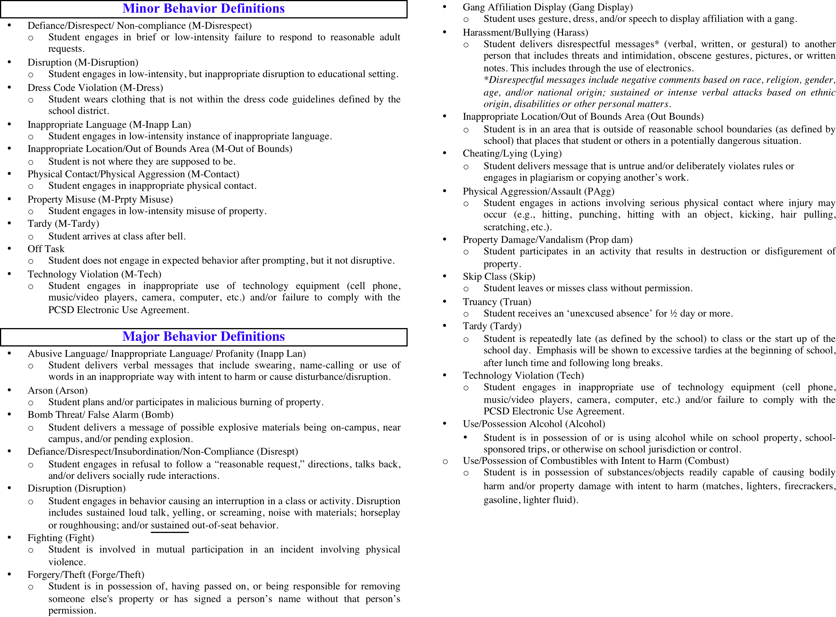

Slide 35
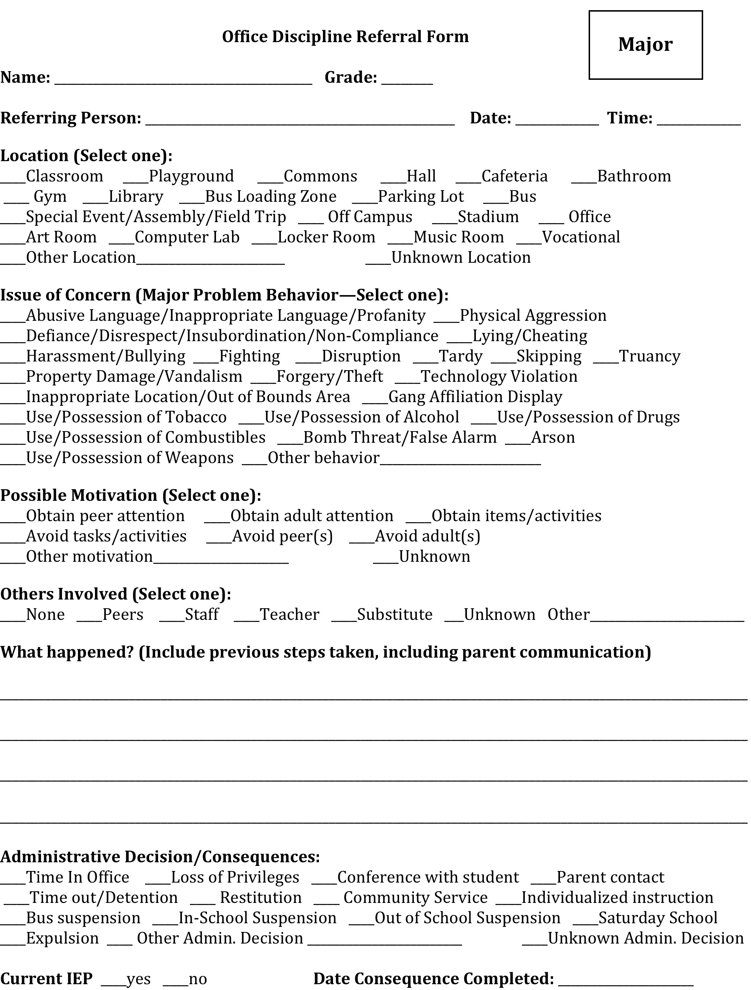


Slide 36
Implementation Steps: Step 8 of “8 Steps”
Establish a school-level PBIS Leadership Team
School-behavior purpose statement
Set of positive expectations and behaviors.
Procedures for teaching school-wide expected behaviors
Procedures for teaching classroom wide expected behaviors.
Continuum of procedures for encouraging expected behaviors.
Continuum of procedures for discouraging rule violations.
Procedures for on-going data-based monitoring and evaluation.

Slide 37

Step 8: Data-based Decision-Making
Data from referrals is entered into school data collection system.
Data reports are run before Leadership Team meetings. Data is used to determine areas in need of interventions.

Slide 38
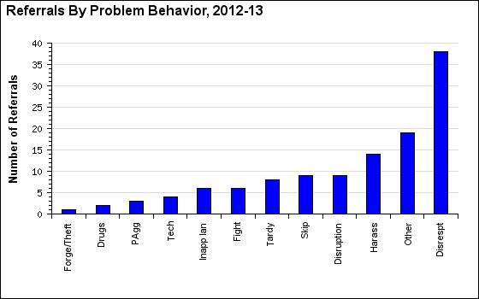

Slide 39
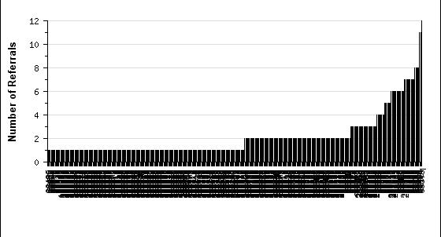
Sample Graph: referrals by student
6+ referrals
0-1 referral
2-5 referrals
Adapted from: swis.org“demo”

Slide 40
How do the “8 steps” fit together?
Reward System
Violation System
Teaching (lesson plans)
Behavior Matrix
Notes:
Applied Behavior Analysis

Slide 41

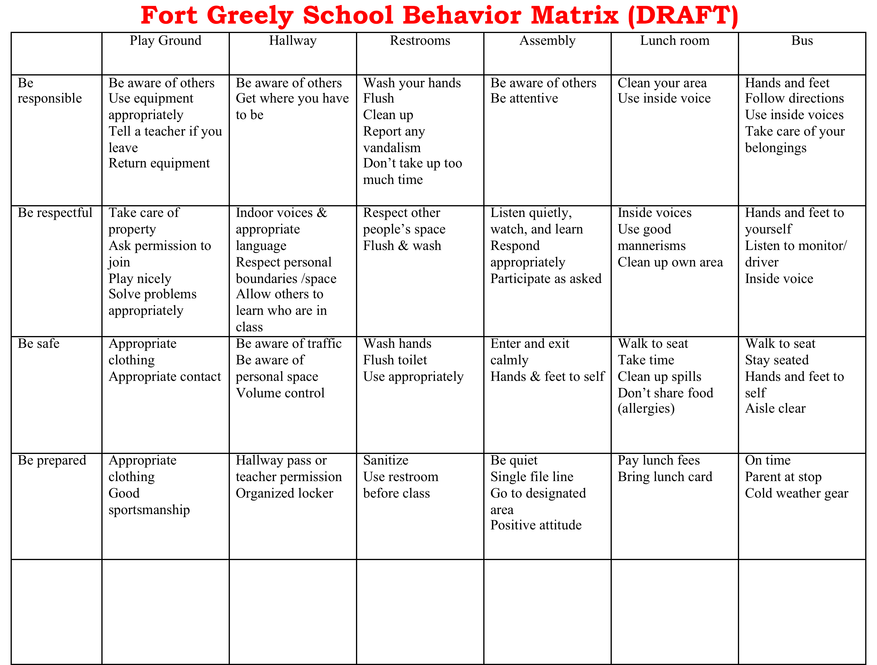
Behavior
Reward System
(positive consequence)
Teaching
(antecedent)
Violation System
(non-preferred consequence)

Slide 42
PROJECT: One-page PBIS
“quick tips” for K-5, MS, HS
Usable by Paras transitioning, subs, etc.
Include:
  Contacts for help
  What is the SW-PBIS strategy
  Purpose Statement & Matrix
  How to re-teach (questions to ask)
  Reward System
  Discipline System

