Slide 1

Positive Behavior Interventions & Supports
Framework Development
Work session: Day 1

Slide 2
Day 1
Participants will:
Have an understanding of Tier 1 School Wide Positive Behavior Interventions & Supports (SW-PBS): “8 Steps of Implementation”.
Have an understanding of you districts data collection system ( School wide Information System (SWIS)) and pbisassessment.org and their role in data based decision making.
Have an understanding of the School-wide PBS school infrastructure.
Work session: Complete the district wide behavior matrix.
Notes:
Lilly

Slide 3
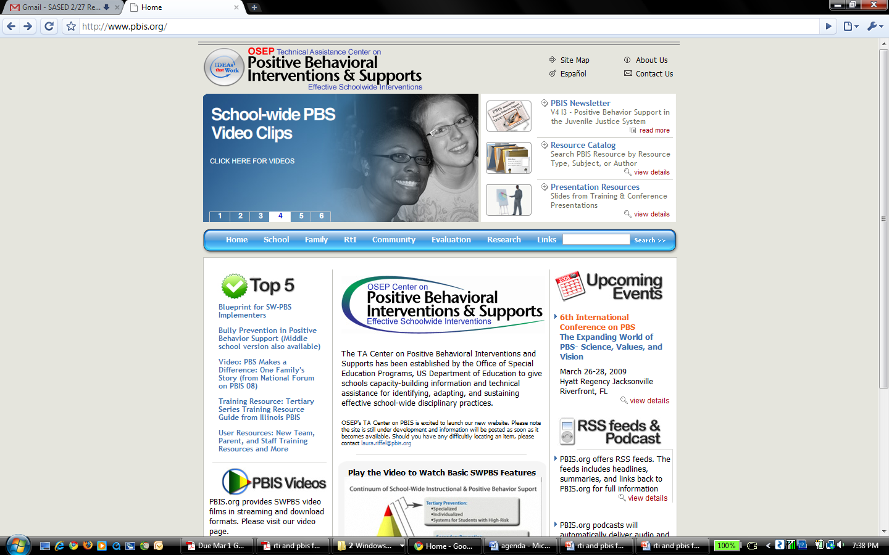
www.pbis.org
Notes:
National resource page

Slide 4
Designing School-Wide Systems for Student Success
Academic Systems
Behavioral Systems
Intensive, Individual Interventions
Individual Students
Assessment-based
High Intensity
Intensive, Individual Interventions
Individual Students
Assessment-based (Data Driven)
Intense, durable procedures
1-5%
1-5%
Targeted Group Interventions
Some students (at-risk)
High efficiency
Rapid response
5-10%
5-10%
Targeted Group Interventions
Some students (at-risk)
High efficiency
Rapid response
80-90%
Universal Interventions
All settings, all students
Preventive, proactive
Universal Interventions
All students
Preventive, proactive
80-90%
www.pbis.org
Notes:
If s Childs' antisocial behavior is not changed by the end of grade 3 it should be treated as a chronic condition and managed with continued supports and interventions (Walker, Colvin, Ramsey, 1995) (compare to diabetes where with adaptations to life diabetics and lead a normal life)
Like academic instruction, students will need differing levels of behavioral intervention and supports throughout their educational career to be successful.

Slide 5
What is School-Wide
Positive Behavior Interventions & Supports?
SW-PBIS is:
  Evidence-based (over 10,000 schools in the US).
  General education initiative.
  A structural framework, NOT a curriculum, intervention, or practice.
  It is a Decision making framework.
  A positive approach based on teaching students appropriate behavior.
  Individualized for each school.
  An excellent match for Alaskan schools:
    Cultural match
    Rural/remote match
Adapted from pbis.org
Notes:
A framework or approach comprised of evidence-based interventions practices and organizational systems for establishing the social culture, learning and teaching environment, and individual behavior supports needed to achieve academic and social success for all students.
General education intervention (not special education)
Implementation of behavior support strategies, along a continuum of intensity, through a process that is focused on social behavior instruction, guided by data based decision-making, and consistent implemented across school environments.
Improving student academic and behavior outcomes is about ensuring all students have access to the most effective and accurately implemented instructional and behavioral practices and interventions possible. SWPBS provides an operational framework for achieving these outcomes. More importantly, SWPBS is NOT a curriculum, intervention, or practice, but IS a decision making framework that guides selection, integration, and implementation of the best evidence-based academic and behavioral practices for improving important academic and behavior outcomes for all students.

Slide 6
Why SW-PBIS?
Decrease development of new problem behaviors
Prevent worsening of existing problem behaviors
Redesign learning/teaching environments to eliminate triggers & maintainers of problem behaviors
Teach, monitor, & acknowledge pro social behavior
www.pbis.org
Notes:
Basis is applied behavior analysis.
Change the antecedent or consequence and you can change the behavior.

Slide 7
Misconception: “SW-PBIS is an intervention or practice.”
Comprised of research-based behavioral practices and interventions that have been shown to improve social behavior and academic achievement,
“Framework” or “approach” that provides the means of selecting, organizing and implementing these evidence-practices by giving equal attention to:
  clearly defined and meaningful student outcomes
  data-driven decision making and problem solving processes
  systems that prepare and support implementers to use these practices with high fidelity and durability.
www.pbis.org

Slide 8
Evidence-based features of SW-PBIS?
    Prevention
    Basic principles of applied behavior analysis.
    Define and teach positive social expectations
    Acknowledge positive behavior
    Arrange consistent consequences for problem behavior
    On-going collection, self-evaluations and use of data for decision-making
    Continuum of intensive, individual interventions
    Administrative leadership and Team-based implementation (systems that support effective practices)
Notes:
Follow basic logic, but use resources and tools to accomplish what you would like to achieve.
Continue to “check in” with key stake holders:
Parents
School Board
Staff

Slide 9
What Does Effective SW-PBIS Look Like ?
>80% of students can tell you what is expected of them & give behavioral example because they have been taught, actively supervised, practiced, & acknowledged.
Positive adult-to-student interactions exceed negative.
Function based behavior support is foundation for addressing problem behavior.
Data- & team-based action planning & implementation are operating.
Administrators are active participants.
Full continuum of behavior support is available to all students
Common language among students, staff, community, and family.
www.pbis.org

Slide 10
How Families and Community can Support SW-PBIS Initiative
What to share with families?
  Share the “big picture” of SW-PBIS framework.
  Expectations – how they can support the behavior expectations in other non-school settings
  How they can support reinforcements & consequences across environments.
  Plan on giving updates of behavior data just like academics.
  See how they can get involved or support the school-wide plan.
  Sample of SW-PBIS matrix for home.
Adapted from www.pbis.org

Slide 11
Installation: the beginning of a unified approach to collecting data, teaching behavior expectations, and implementing the reward systems.
Common Language
MEMBERSHIP
Common Experience
Common Vision/Values
www.pbis.org

Slide 12
Social Competence &
Academic Achievement
What does SW-PBIS
Emphasize?
OUTCOMES
Supporting
Decision
Making
Supporting
Staff Behavior
SYSTEMS
DATA
PRACTICES
Supporting
Student Behavior
www.pbis.org
Notes:
In general, SWPBS emphasizes four integrated elements: (a) data for decision making, (b) measurable outcomes supported and evaluated by data, (c) practices with evidence that these outcomes are achievable, and (d) systems that efficiently and effectively support implementation of these practices.

Slide 13
Stages of Implementation
2-3 yrs
Exploration/ Adoption
Installation
Development Commitment
Initial Implementation
Establish Leadership Teams, Set Up Data Systems
Full Implementation
Provide Significant Support to Implementers
Innovation and Sustainability
Embedding within Standard Practice
Should we do it?
Improvements: Increase Efficiency and Effectiveness
Doing it right
Doing it better
Adapted from www.pbis.org
Notes:
Administration and staff has established commitment
Next step is professional development to learn about PBIS and what is the next steps towards implementation.

Slide 14
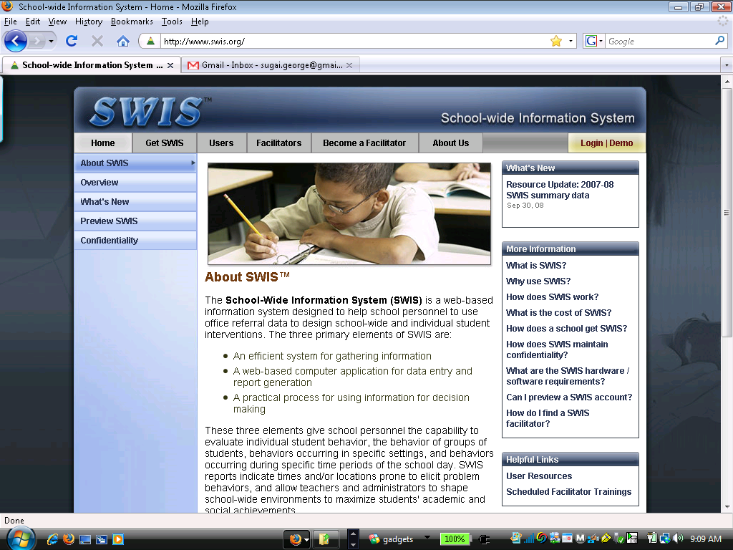
www.swis.org

Slide 15
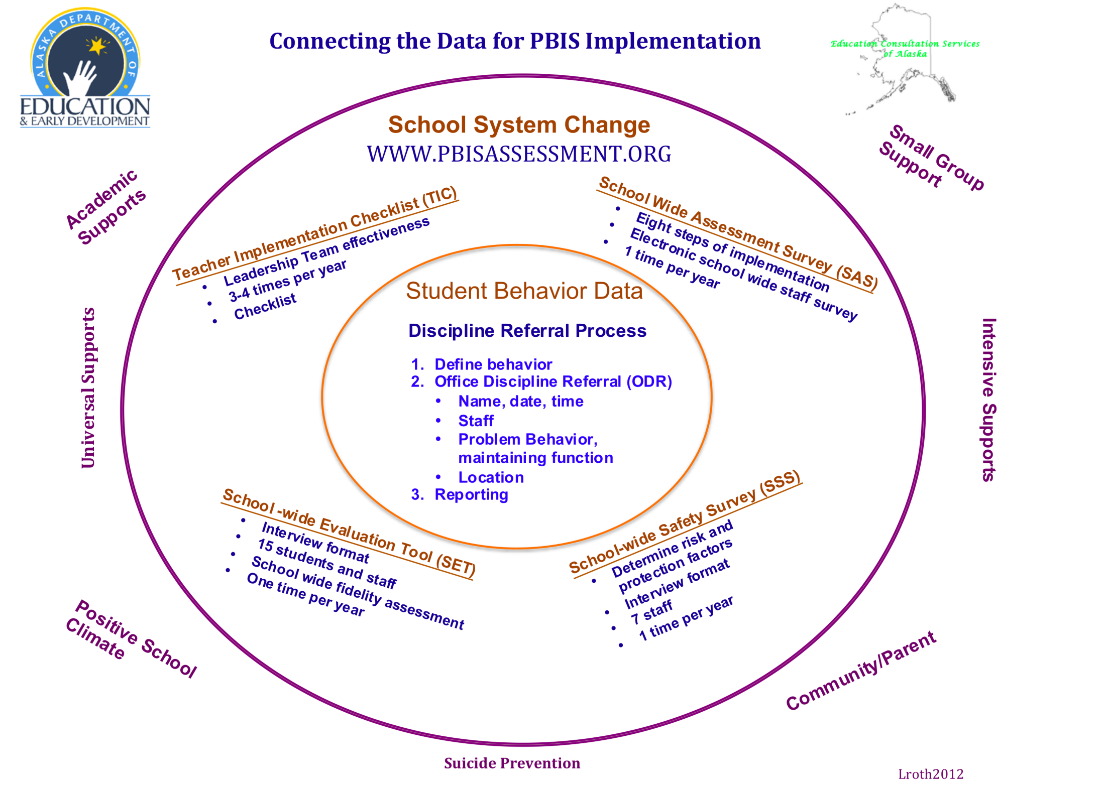

Slide 16
What Types of data are suggested?
1. School System Data

Slide 17
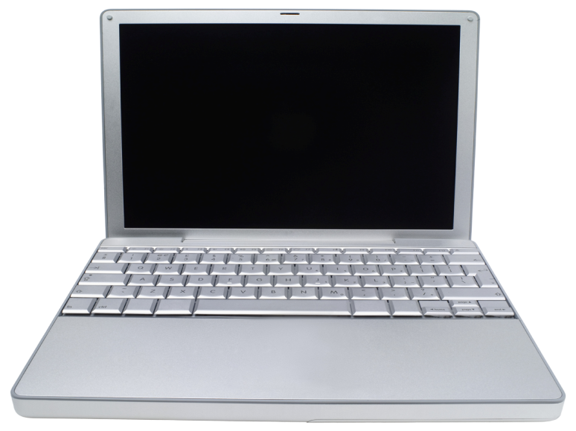
www.pbisassessment.org
System Data
  Staff surveys and assessments
    Self Assessment Survey (SAS)
    School Evaluation Tool (SET)
    Team Implementation Checklist (TIC)
    School Safety Survey (SSS)
Notes:
Discuss assessment versus survey

Slide 18
The School Wide Assessment Survey (SAS)
Measures the perspective from staff for schools to identify the status and priority for improvement in (4) four areas. Responses should be 100% across all areas if Tier 1 PBIS is being implemented with fidelity.

Slide 19
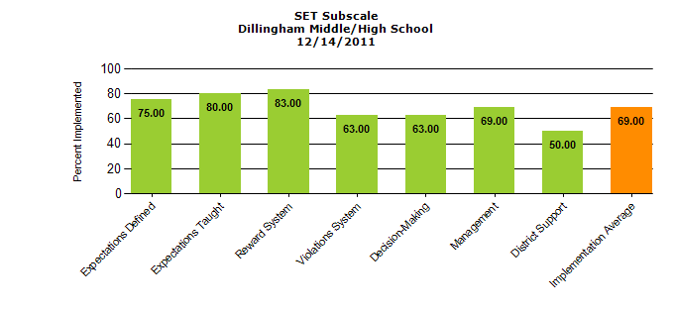
The School Wide Evaluation Tool (SET)
This research tool is designed to measure the critical features of PBIS annually through verbal interview with an administrator, a small number of students, and building staff by the SET evaluator. The SET measures the fidelity of implementation of the Tier 1 interventions based on the verbal responses.

Slide 20
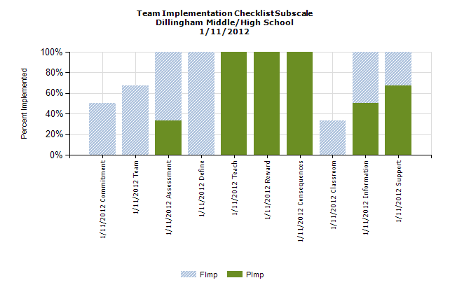
Team Implementation Checklist (TIC)
Is a monitoring tool for school teams implementing PBIS. Completed by the Leadership Team to self-evaluate their effectiveness and goal preparation. Completed three to four times per year, as appropriate.

Slide 21
School Safety Survey (SSS)
This survey is to be completed by the PBIS coaches through an interview format. The survey is conducted annually and is used to access and identify Risk and Protection Factors for the school.

Slide 22
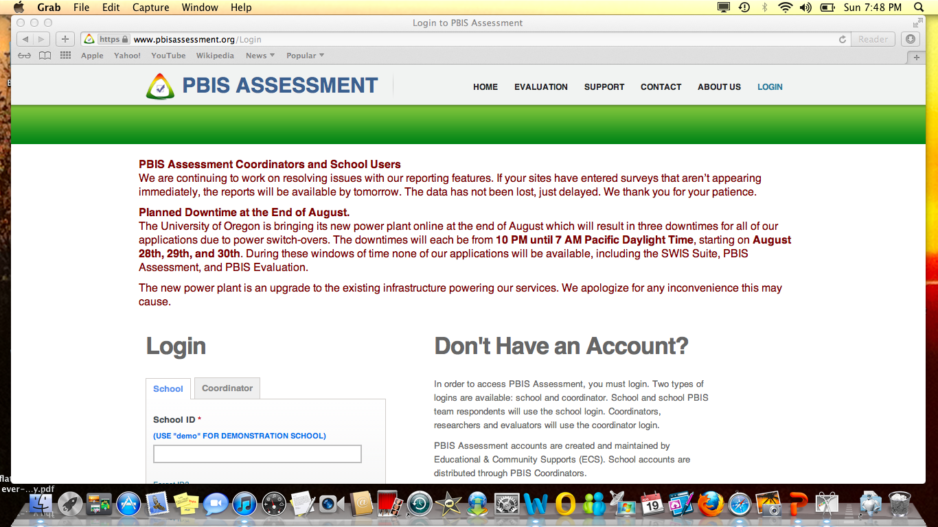
www.pbisassessment.org

Slide 23

2. Student Behavior Data

Slide 24
Key features of discipline data systems that works.
Behaviors are operationally defined.
The data are very easy to collect (1% of staff time)
  Office Discipline Referral Form
Data are presented in picture (graph) format
Data are used for decision-making
    The data must be available when decisions need to be made (weekly?)
    Difference between data needs at a school building versus data needs for a district
    The people who collect the data must see the information used for decision-making.

Slide 25
Minor vs. Major: what’s the difference?
Major Behaviors: Discipline incidents that must be handled by the administration.
Minor Behaviors: Discipline incidents that can be handled by the classroom teacher and usually do not warrant a discipline referral to the office.
Notes:
For some behaviors major/minor defined based on level of intensity.
Minor behaviors may be tracked for repeated offenses leading to a major intervention strategy.

Slide 26
Behavior Incident types.
Major Behaviors
Some examples:
physical fights, property damage, drugs, weapons, tobacco, etc.
Noncompliance, disrespect (others)
Minor Behaviors
Some examples:
tardiness to class, lack of classroom material, incomplete classroom assignments, gum chewing, etc.
Noncompliance, disrespect (others)
Notes:
Major:
Once problem behaviors are operationally defined, it is essential that the team distinguish the major discipline incidents from the minor to determine the appropriate consequence
Minor:
Purpose
To determine appropriate consequence and where the consequence should be delivered
* These incidences are still tracked but the consequence is delivered in the classroom

Slide 27
Sneak Peak at SWIS™
www.swis.org
Notes:
Open SWIS to big 5 graphs if have internet. If not, input slides.

Slide 28
Basic Features of SWIS™
Only reports on discipline.
Web-based data collection system.
Real-time data.
Local control.
Prints graphics for decision-making.
Confidential and secure.
SWIS™ facilitator for support.
Adapted from www.swis.org
Notes:
Major Behaviors: Discipline incidents that must be handled by the administration.
Minor Behaviors: Discipline incidents that are handled by the classroom teacher and usually do not warrant a discipline referral to the office.

Slide 29
SWIS “Big 5 Reports”
Major data points
Student name
Date
Location of behavior
Time of behavior
Type of behavior
Adapted from www.swis.org
Notes:
Major behaviors defined as those needing administrative interventions
Minor behaviors dealt with through classroom management plan.

Slide 30
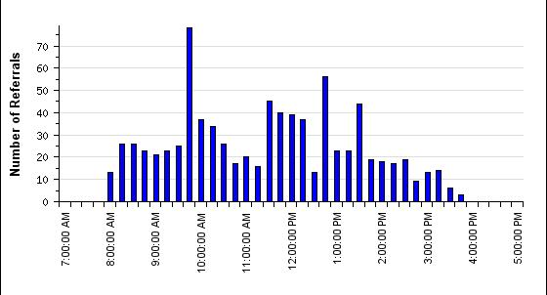
Sample Graph: referrals by time
Taken from SWIS.org demo

Slide 31
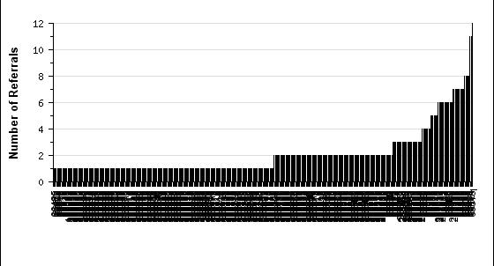
Sample Graph: referrals by student
6+ referrals
0-1 referral
2-5 referrals
Adapted from: swis.org“demo”

Slide 32
Roth, L. 2012

Slide 33
Where are you in implementation process?
Adapted from Fixsen & Blase, 2005
EXPLORATION & ADOPTION
INSTALLATION
INITIAL IMPLEMENTATION
FULL IMPLEMENTATION
SUSTAINABILITY & SCALABILITY
We think we know what we need, so we ordered 3 month free trial
Let’s make sure we’re ready to implement
Let’s give it a try & evaluate
That worked, let’s do it for real
Let’s make it our way of doing business

Slide 34
What do we need to do?
To get ready to implement the “8 Steps of Implementation” for Tier 1

Slide 35
Implementation Steps: Step 1 of “8 Steps”
Establish a school-level PBIS Leadership Team
School-behavior purpose statement
Set of positive expectations and behaviors.
Procedures for teaching school-wide expected behaviors
Procedures for teaching classroom wide expected behaviors.
Continuum of procedures for encouraging expected behaviors.
Continuum of procedures for discouraging rule violations.
Procedures for on-going data-based monitoring and evaluation.
www.pbis.org
Notes:
Student success is achieved through appropriate modeling by adults
Teaching missed social skills through structured environment, repetiion, positive nd negative reinforcement
Establish a school-level PBIS Leadership Team
Teams must realize that they are a leadership team and have the ability to make positive changes in the school. Plan for professional development and technical assistance.
Have roles & responsibilities.
Meet 1-2 times per month.
Establishing a Foundation for Collaboration and Operation – PBIS requires some systems change efforts.
Administration, teachers, paraprofessionals, counselor, mental health, community
2. School-behavior purpose statement
3. Set of positive expectations and behaviors.
Term used to organize the specific social behaviors that are desired or expected in different settings across the school day. (ex. Be safe, be kind, be responsible)
4. Procedures for teaching school-wide expected behaviors
Teachers will prepare lesson plans (models available) to teach the behavior expectations for the non-structured selected settings. Writing lesson plans in a small group and sharing is encouraged. Want all teaching to give the same message.
Teach what the behavior looks like in each setting (replacement behavior)
5. Procedures for teaching classroom wide expected behaviors.
How to make teaching the social skills prior your education curriculum. (refer to matrix for necessary behaviors for classroom instruction)
6. Continuum of procedures for encouraging expected behaviors.
Increase the likelihood the replacement behavior will be used when taught
7. Continuum of procedures for discouraging rule violations.
At minimum verbal praise up to a school-wide reward system for appropriate behaviors
8. Procedures for on-going data-based monitoring and evaluation.
What happens when a student misbehaves. Setting up a consistent set of rules, definitions, and consequences for behavior problems.

Slide 36
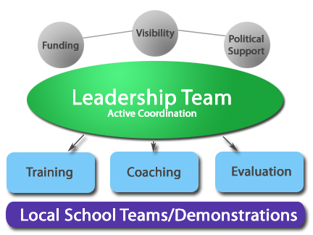
www.pbis.org
Notes:
Made up of a cross section of school and community members. 1-2 with behavior experience.
No more than 5-7 on team. Clearly defined roles & responsibilities.

Slide 38
SW-PBIS Leadership Team Responsibilities
Develop, facilitate and evaluate the fidelity of implementation of Tier 1 PBIS.
Promote team development and communication across staff to maintain a “common focus and language”.
Create data based action plans.
Promote communication to increase efficiency and consistency through:
  PBIS updates at staff meetings
Write a 1-2 year SW-PBIS plan
Sustaining SW-PBIS implementation.
www.pbis.org
Notes:
Representative of demographics of school and community
1-2 individuals with behavior/classroom management competence
Administrator active member
Schedule for presenting to whole staff at least monthly
Schedule for team meetings at least monthly
Integration with other behavior related initiatives and programs
Appropriate priority relative to school and district goals
Rules and agreements established regarding voting, confidentiality and privacy, conflict/problem solving, record-keeping, etc.
Schedule for annual self-assessments
EBS Self-Assessment Survey
Review Office Discipline Referrals
Benchmarks of Quality
School-wide Evaluation Tool
Coaching support (school and/or district/region)

Slide 39
Misconception: “SW-PBIS is something new that was designed for students with disabilities.”
The phrase “Positive Behavioral Interventions and Supports” was first coined in the reauthorization of the IDEA; however, the practices, principles, and systems that characterize PBIS have been described, studied and implemented since the early 1960s and 1970s (Carr, 2007; Carr et al., 2002; Sugai & Horner, 2002).
PBIS is a marriage of behavioral theory, behavior analysis, positive behavior supports, and prevention and implementation science that has been developed to improve how schools select, organize, implement, and evaluate behavioral practices in meeting the needs of all students (Sugai et al., 2000).
www.pbis.org

Slide 40
Implementation Steps: Step 2 of “8 Steps”
Establish a school-level PBIS Leadership Team
School-behavior purpose statement
Set of positive expectations and behaviors.
Procedures for teaching school-wide expected behaviors
Procedures for teaching classroom wide expected behaviors.
Continuum of procedures for encouraging expected behaviors.
Continuum of procedures for discouraging rule violations.
Procedures for on-going data-based monitoring and evaluation.
www.pbis.org

Slide 41
What is a Behavior Purpose Statement?
Positively stated.
Common focus for student emotional development.
Common goal and language
2-3 sentences in length.
Supportive of academic achievement.
Contextually/culturally appropriate.
Comprehensive in scope (school-wide – ALL students, staff, and settings).
Supported and taught by faculty and staff.
Adapted from pbis.org
Notes:
Communicated to stakeholders (e.g., families, community members, district administrators)
Included in school publications (e.g., handbook, posters, newsletters)

Slide 42
Time to Create the District-Wide Behavior Matrix
What is it?

Slide 43
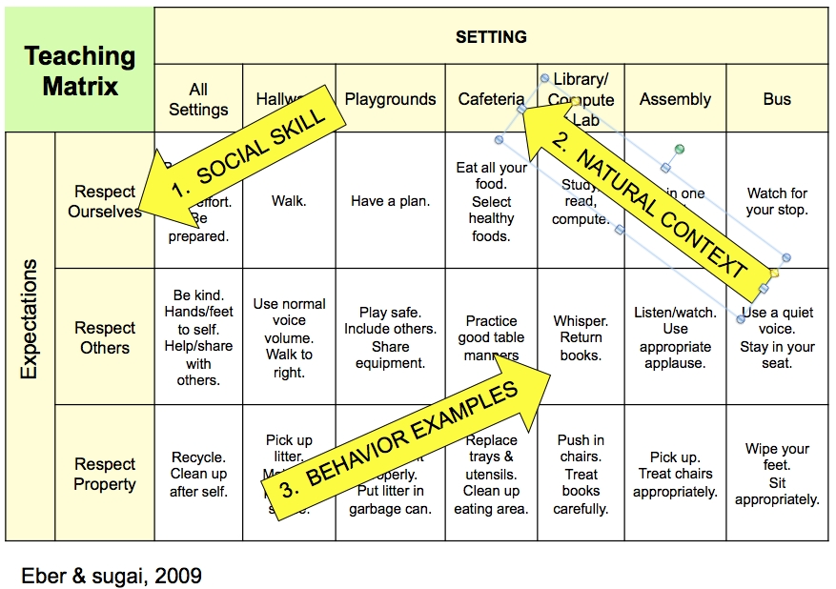

Slide 44
Reward System
Violation System
Teaching
Behavior Matrix
lroth2012
Notes:
Applied Behavior Analysis

Slide 45
Sample Behavior Purpose Statements
We are respectful to the community and ourselves, and we are responsible to our tribe. We value hard work and cooperation.
At School is a community of learners and teachers. We are here to learn, grow, and become good citizens.
At School, we treat each other with respect, take responsibility for our learning, and strive for a safe and positive school for all!

Slide 46
Work Session: Write a District-Wide Behavior Purpose Statement
Brainstorm in your group and write a behavior purpose statement.
Return to large group and report out what written.
Group vote to determine your schools Behavior Purpose Statement.
Each person may vote 2 times.
Notes:
Use activity 1 worksheet

Slide 47
Behavior Purpose Statements From Groups
“Please insert groups statements”

Slide 48
Implementation Steps: Step 3 of “8 Steps”
Establish a school-level PBIS Leadership Team
School-behavior purpose statement
Set of positive expectations and behaviors.
Procedures for teaching school-wide expected behaviors
Procedures for teaching classroom wide expected behaviors.
Continuum of procedures for encouraging expected behaviors.
Continuum of procedures for discouraging rule violations.
Procedures for on-going data-based monitoring and evaluation.
Notes:
Social skills and behaviors taught to reach goal of behavior purpose statement.
Written I by staff during Tier 1 training
Term used to organize the specific social behaviors that are desired or expected in different settings across the school day. (ex. Be safe, be kind, be responsible)
Discuss and determine non-structured areas of school in most need of interventions. Determine behaviors students are experiences an what behaviors they would like the students to utilize instead (replacement behaviors). Basis of matrix and social skills program.

Slide 49
Identify Positive School Wide Behavior Expectations
Linked to social culture of school (e.g., community, mascot).
Considerate of social skills and rules that already exists.
3-5 in number
1-3 words per expectation
Positively stated
Supportive of academic achievement
Comprehensive in scope (school-wide – ALL students, staff, and settings)
Mutually exclusive (minimal overlap)
Contextually/culturally appropriate (e.g., age, level, language)
Agreement by >80% faculty and staff

Slide 50
School Wide Behavior Expectations
Why is this important?
Provides consistency in language
Provides consistency in what to teach
Provides consistency in what to recognize
Provides consistency in what to correct
Can be implemented and reinforced across environments
The social/emotional skills your students need to achieve your behavior purpose statement

Slide 51
Work Session: Identify 3 Behavior Expectations
Brainstorm in your group.
Identify 3 Behavior Expectations to be taught to all students (e.g. Be respectful).
Behavior Expectations promote social emotional growth to achieve the Behavior Purpose Statement
State all Behavior Expectations in positive terms (2-3 words).
Identify spokesperson for reporting out to large group.
Notes:
Use activity 2 worksheet this activity will continue on slide 54

Slide 52
Expectations & behavioral skills are taught & recognized in natural context
Expectations

Slide 53
Sample Behavior Expectations
Be respectful
Be safe
Be positive
Be cooperative
Be responsible
Be proud
Be kind
Be cooperative
Be successful
Be accountable
Be hardworking
Be a learner

Slide 54
Work Session: Write 3 District-Wide Behavior Expectations
Return to large group and report out what was selected.
Group vote and select top 3 district wide behavior expectations for behavior matrix.
Each person may vote 2 times.
Notes:
Facilitate as a large group for voting continuation of activity sheet #2

Slide 55
Behavior Expectations Report Out (insert choices)

Slide 56
Non-structured locations
Samples
Hallways
Bathroom
Lunch area
School grounds
School bus
Auditorium
Community
Notes:
No activity provided

Slide 57
Behavior Definitions
Individual skills that will be taught to students as an alternative to unwanted behaviors for each non-structured environment.
Taught to promote growth towards the behavior expectations for each environment.

Slide 58
Work Session: Write Behavior Definitions for Select Location
1 “location” per group.
Brainstorm in your group to determine 2-3 skills to teach for each behavior expectation.
Return to large group and report out behavior definitions to be placed on matrix.
Notes:
Use activity sheet #3

Slide 59
Completed Matrix!
Insert your matrix here.

Slide 60
Afternoon Session

Slide 61
Share District Matrix

Slide 62
Participants Will:
Develop an understanding of the components of teaching social emotional skills.
Work session: Develop a template and begin writing lesson plans for teaching non-structured behavior expectations.
Write lesson plans for non-structured settings.
Group sharing of at least 2 completed lesson plans.
Model 1 lesson for group.

Slide 63
Implementation Steps: Step 4 of “8 Steps”
Establish a school-level PBIS Leadership Team
School-behavior purpose statement
Set of positive expectations and behaviors.
Procedures for teaching school-wide expected behaviors
Procedures for teaching classroom wide expected behaviors.
Continuum of procedures for encouraging expected behaviors.
Continuum of procedures for discouraging rule violations.
Procedures for on-going data-based monitoring and evaluation.
Notes:
Social skills and behaviors taught to reach goal of behavior purpose statement.
Written I by staff during Tier 1 training
Term used to organize the specific social behaviors that are desired or expected in different settings across the school day. (ex. Be safe, be kind, be responsible)
Discuss and determine non-structured areas of school in most need of interventions. Determine behaviors students are experiences an what behaviors they would like the students to utilize instead (replacement behaviors). Basis of matrix and social skills program.

Slide 64
Phases of Learning
White & Haring, 1980
Acquisition
New skill w/ accuracy
Fluency
Speed & consistency
Maintenance
Sustained w/ accuracy & fluency
Practice w/ less feedback
Show, model, explain w/ feedback
Practice w/ feedback
Generalization
Use in new context
Adaptation
Modify & fit behavior in new context
Teach variations w/ feedback
Teach, practice in variety of conditions

Slide 65
STEP 4 – Develop Lesson Plan for Teaching School Wide Positive Behavior Expectations
Considerate of main school settings and contexts (e.g., classroom, common areas, hallways, cafeteria, bus)
Considerate of lessons that already exists.
Specification of 2-3 positive observable behavior examples for each expectation and each setting/context.
Teach social behavior like academic skills.
Involvement by staff, students, families in development
Contextually/culturally appropriate (e.g., age, level, language)
Schedule for initial instruction in natural and typical contexts
Include in lesson planning as academics.

Slide 66
Lesson Plan for Teaching School Wide Positive Behavior Expectations
Schedule instruction for regular review, practice, and follow-up instruction.
for display of behaviors in natural contexts and settings.
Feedback (corrections and positive acknowledgements) for displays of behaviors in natural contexts and settings.
Procedures in place for identifying and supporting students whose behaviors do not respond to teaching school-wide behavior expectations.

Slide 67
Other thoughts
Processes for teaching substitutes, new faculty, staff, students, etc.
Procedures for informing others (e.g. families, community, district administrators, substitute teachers & staff)
Schedule for continuous evaluation of effectiveness, efficiency, and relevance of teaching
Schedule of teaching behavior expectations across schools/building.
Include in school publications, etc.
  Ex. As part of our PBIS initiative, this week we will be teaching……..

Slide 68
Method to teach social emotional skills
Tell +
Show +
Practice +
Feedback +
Re-Teach and
Don’t forget to reinforce!

Slide 70
Work Session: Lesson Planning
Write lesson plans
Notes:
Use activity sheet #4

Slide 71
Report Out
Each group share:
  Share template and how it fits into SW-PBIS instructional format.
  2 lesson plans
  Model 1 lesson plan for group.

Slide 72
Presentation prepared by:
Lori Roth, MEd.
PBIS Data & Implementation Coach
Education Consultation Services of Alaska
lroth507@gmail.com
Sharon Fishel
State SW-PBS Coordinator
Alaska Department of Education & Early Development
Education Specialist II
Sharon.Fishel@alaska.gov
www.education.alaska.gov

