Slide 1
Your Agency can Support a School-wide Positive Behavior Interventions & Supports (PBIS) Initiative: Here is how!
Insert school/BHA graphic here
Notes:
Kelly

Slide 2
Goals of this Presentation:
To learn the basics of Tier 1 school-wide PBIS.
To learn how your agency can support schoolwide PBIS in the local school.

Slide 3
Understand the acronyms:
PBS=Positive Behavior Supports
PBIS=Positive Behavior Intervention & Supports
SWPBS=School-wide Positive Behavior Supports
SW-PBIS=School-wide Positive Behavior Interventions & Supports
Others?

Slide 4
Where it is being implemented in Alaska?
= Alaska School Districts

Slide 5

SW-PBIS is a broad range of systemic and individualized strategies for achieving important social and learning outcomes while preventing problem behavior
OSEP Center on PBIS
Notes:
SW-PBS is:
Evidence-based (over 10,000 schools in the US)
A structural framework, NOT a curriculum, intervention, or practice
It is a Decision making framework
A positive approach based on teaching students appropriate behavior
Individualized for each school
An excellent match for Alaskan schools
Cultural match
Rural/remote match

Slide 6
Understand what PBIS is….
Evidence-based practice.
Framework to promote social skill development and establish a more effective learning environment.
Starts with prevention first.
Actively invest in doing things before the children make mistakes.
Active reinforcement from verbal to tangible reinforcement through the eyes of the students.
Notes:
Stress that it is proactive, preventative and positive.

Slide 7
FYI….Research on SW-PBIS states schools may see:
Increased attendance
Increased positive social interactions between staff and students
Increased learning (test scores)
Increased graduation rate
Increased teacher retention
Improve school efficiency
Increased administrative time
Perception of increased teacher effectiveness
Decreased truancy
Decreased bullying
Decreased drop-out rate
Decrease Office Discipline Referrals
Proactive, preventative measure for suicide
Adapted from Rob Horner, Nov 2012. Northwest PBIS Coaching Conference Keynote
Notes:
Behavioral health staff could share this with parents. Helps to gain an understanding of the short and long term positive effects.

Slide 8
Understand the goals for the school’s SW-PBIS initiative. What is your role?
80% of students (and staff) can tell you what is expected of them. They can give behavioral example because they have been taught, actively supervised, practiced, & acknowledged
Common language among students, staff, community, and family. The school environment is free of triggers that maintain problem behaviors.
Create an effective learning environment that is physically and emotionally safe for all.
Create a predictable, consistent, and positive school environment that promotes learning.
Full continuum of behavior support is available to all students within school through inter-agency collaborations.
Rob Horner, Nov 2012. Northwest PBIS Coaching Conference Keynote
Notes:
Through this the agencies can speak the same language as school staff.

Slide 9
Determine who can support PBIS!
School
Family
Behavioral Health Agency
Student
Notes:
Everyone needs to work together for a common focus.

Slide 10
Learn and practice a “common focus & language” used by everyone in building…including behavioral health staff!
Common Language
MEMBERSHIP
Common Experience
Common Vision/Values
Adapted from www.pbis.org
Notes:
Common language: all say the same thing
Common vision: instruction going the same way
Common experience: everyone knows everyone knows (kids expect others to behave well and staff expect staff to model and teach)

Slide 11
Understand the Stages of Implementation: School & Agency.
Exploration/ Adoption
2-3 yrs
Installation
Development Commitment
Establish Leadership Teams, Set Up Data Systems
Initial Implementation
Full Implementation
✔
Provide Significant Support to Implementers
Innovation and Sustainability
Embedding within Standard Practice
Improvements: Increase Efficiency and Effectiveness
BHA Here
SD is here.
Adapted from www.pbis.org
Notes:
Explain the long-term commitment. A school can expect to work on SW-PBIS for up to 10 years until sustainable within school culture. Depending on when Behavioral Health Agencies become involved they may not be in the same place as the school and that is OK.

Slide 12
Come up with a common and easy way to explain to parents:
A proactive, consistent, preventative social skills framework to promote a more effective learning environment.
Starts with prevention first. Proactive investment in doing things before the children make mistakes.
Based on evidence-based practices
Structures reinforcement systems from verbal praise to tangible items created through the eyes of students (and staff).
Rob Horner, Nov 2012. Northwest PBIS Coaching Conference Keynote
Notes:
Explain it simple.
Why need students involved?

Slide 13
Social Competence, Treatment &
Academic Achievement
Supporting
Staff Behavior
Office Discipline Referrals
Reward system data
Suspension, expulsion,
graduation rate,
Replacement behavior data
Intake process,
Client Status Review
Other?
School District policy and procedures
Behavioral Health policy & procedures.
OUTCOMES
SYSTEMS
DATA
Supporting
Decision
Making
PRACTICES
Supporting
Student Behavior
Teaching behavior classroom/non-structured behavior expectations
.Interdisciplinary Team meetings & Treatment Planning.
Implementing positive consequence system
Implementing negative consequence system
Evidence-based academic instruction/assessment
Adapted from www.pbis.org
Notes:
In general, SWPBS emphasizes four integrated elements: (a) data for decision making, (b) measurable outcomes supported and evaluated by data, (c) practices with evidence that these outcomes are achievable, and (d) systems that efficiently and effectively support implementation of these practices.

Slide 14
Designing School-Wide Systems for Student Success
Academic Systems
Behavioral Systems
Intensive, Individual Interventions
Individual Students
Assessment-based
High Intensity
Intensive, Individual Interventions
Individual Students
Assessment-based (Data Driven)
Intense, durable procedures
1-5%
1-5%
Targeted Group Interventions
Some students (at-risk)
High efficiency
Rapid response
5-10%
5-10%
Targeted Group Interventions
Some students (at-risk)
High efficiency
Rapid response
80-90%
Universal Interventions
All settings, all students
Preventive, proactive
Universal Interventions
All students
Preventive, proactive
80-90%
www.pbis.org
Notes:
If s child’s antisocial behavior is not changed by the end of grade 3 it should be treated as a chronic condition and managed with continued supports and interventions (Walker, Colvin, Ramsey, 1995)
Like academic instruction, students will need differing levels of behavioral intervention and supports throughout their educational career to be successful.

Slide 15
Special Education & 504s
Academic
PBIS
Tier 3 RtI—Intensive individualized instruction, Progress monitoring, student contract, Tutoring, Coaching
Tier 3 PBIS--Referrals to community counseling agencies & programs, Individual counseling, CPI, FBA/Behavior Plans
Tier 2 RtI--Aimsweb/Progress Monitoring, Curricular Modifications, Small Group Lessons, Literacy Specialist, Fast ForWord, Homework Support, Math Whizz
Tier 2 PBIS--Small group interventions, CPI, Behavior contract, Check-In Check-Out
Tier 1 PBIS--Matrix lesson plans, Positive reinforcement systems (school -wide & classroom), Guidance counseling curriculum
Tier 1 RtI--SBAs, MAP, General Ed Curriculum, DRAs
Current School District Response to Intervention/Instruction
Notes:
For this slide please add school district specific interventions these listed are just a sample.

Slide 16
In/Out State Residential Placement, Hospitalization, Step down residential placement,
Behavioral Health Service Delivery by Tiers of Support
Home/School based
Educational Service Delivery by Tiers of Support
PBIS Tier 3: Intensive Individualized Interventions 6 or more Office Discipline Referrals
General Education with support, Functional Behavior Assessment, Behavior support plan, Special Education Referral, 504 Referral/ Plan, Crisis intervention, PBIS data-based decision-making & planning. Suicide Intervention (ASIST)
Tier 3: Intensive therapeutic support
Family & small group support, Full time wrap around support, School based services, Case management, Treatment plan development & review, Crisis intervention, Therapeutic foster care,
Tier 2: Out Patient Services
Therapeutic targeted small groups in and out of school, Family support, wrap around services, Intake process, Case management, Client status review, Treatment planning development & review, Crisis intervention
PBIS Tier 2: 2-5 Office Discipline Referrals (Targeted small group interventions)
Intervention Action Planning, Check In-Check Out, School counselor targeted small groups, School counselor check-in support, Suicide intervention (AK Gatekeeper, ASIST), Mentor programs, Peer support programs, Crisis Prevention Intervention, Bully-prevention targeted interventions.
Tier 1:Universal Awareness/ screening activities
Stand by for crisis intervention/ assessment, community awareness activities, educational topical support (drugs, alcohol, tobacco, suicide prevention), etc. Relationship building.
PBIS Tier 1: 0-1 Office Discipline Referrals (School-wide Universal Supports)
School-wide matrix development & lesson plans, school violation & positive reinforcement systems (school -wide & classroom), Data based decision-making, Guidance counseling curriculum. Safe TALK/ Kognito/ SOS suicide prevention training/screening, Bully prevention training.
5-13-13
Notes:
This shows service delivery options by tier of support.
Please remember that students can move from one tier to another.

Slide 17
Roles of:
District Administration, Behavioral Health Agency, and school-based teams
?

Slide 18
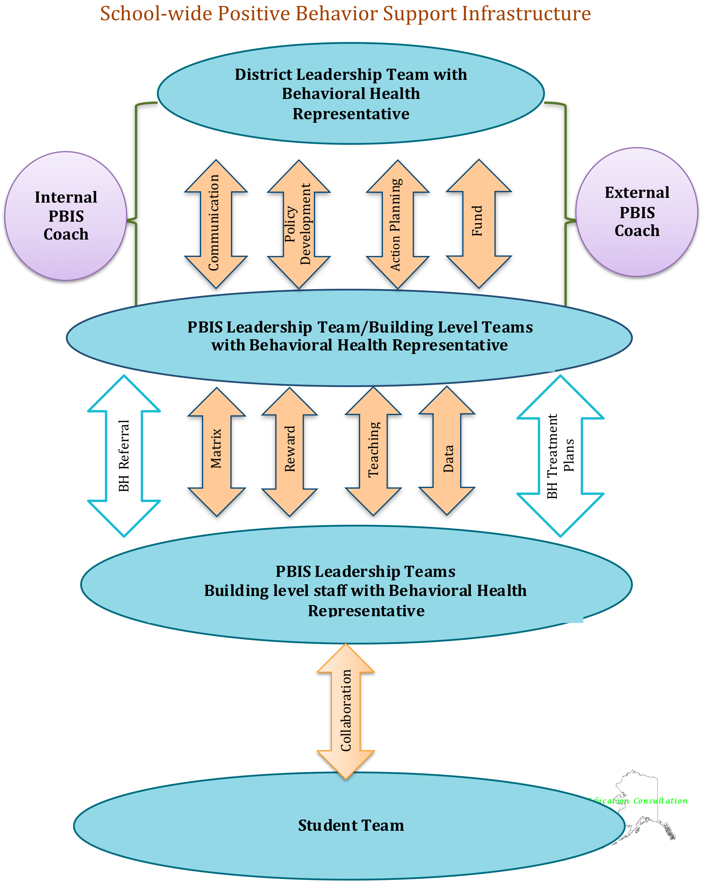

Slide 19
Define Administration’s Roles and Responsibilities
Administrator should be familiar with school’s current data and reporting system
Administrator should play an active role in the school-wide and agency PBIS implementation process
Support Behavioral Health staff
ALL administrators are encouraged to participate in the process
Administrators should actively communicate their commitment to the process
If a school principal or behavior health agency director is not committed to the PBIS process, it is unwise to move forward with a collaborative process!

Slide 20
Coaching Support to Behavioral Health Agencies
Internal Coach
Day to day resource for school and behavior health support.
Oversees the PBIS process and keeps it moving internally.
Checks in with Implementation Team(s) for fidelity.
Promote communication and collaborative interventions.
Streamline referral process for Tier 2 & 3.
External Coach
Provide PBIS professional development for Agency staff.
Design the “road map” for implementation and collaboration.
Keep things going.
Provide resources and “cheat sheets”.
Support the Internal Coach and Behavior Health Agency.

Slide 21
Get to Know Tier 1 in the SW-PBIS Implementation Process
Tier 3
Tier 2
Tier 1

Slide 22
And what they will do to get there!
Tier 1 Implementation“8 Steps”
Establish a school-level SW-PBS Leadership Team
School-behavior purpose statement
Set of positive expectations and behaviors.
Procedures for teaching school-wide expected behaviors
Procedures for teaching classroom wide expected behaviors.
Continuum of procedures for encouraging expected behaviors.
Continuum of procedures for discouraging rule violations.
Procedures for on-going data-based monitoring and evaluation.
Tier 1
Notes:
Help staff understand these are the necessary steps to implement SW-PBIS. It is evidence-based and supported through research. This is very comprehensive and may require some school systems to be reviewed and refined. Want to make systems better and not replace what is already working.
Consistent or implementing with fidelity will screen out 80% of students having their needs met through the discipline referral process. Allow to identify students requiring more support such as….School based leadership team to monitor the implementation of the eight steps
If staff on board can be in place in a few months.

Slide 23
Tier 1-Step 1: Establish a School-wide PBIS Leadership Team
What is the agencies role with the School-wide PBIS Leadership Team?

Slide 24
SW-PBIS Leadership Team: Identify key players (3-8 members)
District
School
*Behavioral Health Agency
Responsible for district wide commitments and SW-PBIS planning
School Administrative Team must be committed to SW-PBIS and actively participate on the team
Responsible for student and building wide SW-PBIS planning and implementation
SW-PBIS school leadership team should remain small (3-8 members)
Promote interagency collaboration
Provide community and in-home updates
Support home-school communication and support (Tier 2 & 3)
Assist with Agency linkages for student support.
Crisis response/ interventions.
Counseling support
Data sharing
*As appropriate
Notes:
This slide shows the collaboration that can happen on the leadership team and the different perspectives they can bring.

Slide 25

Discussion
How can your agencies support the SW-PBIS leadership team?
What role do you play?
Notes:
5 to 10 minute group discussion to determine common focus.

Slide 26
Tier 1-Steps 2 & 3: Behavior Purpose Statement and Positive Behavior Expectations
What’s behavioral health’s role with the PBIS initiative?

Slide 27
Understand the school wide matrix..
Notes:
Insert your schools matrix here and create a matrix for your agency.

Slide 28
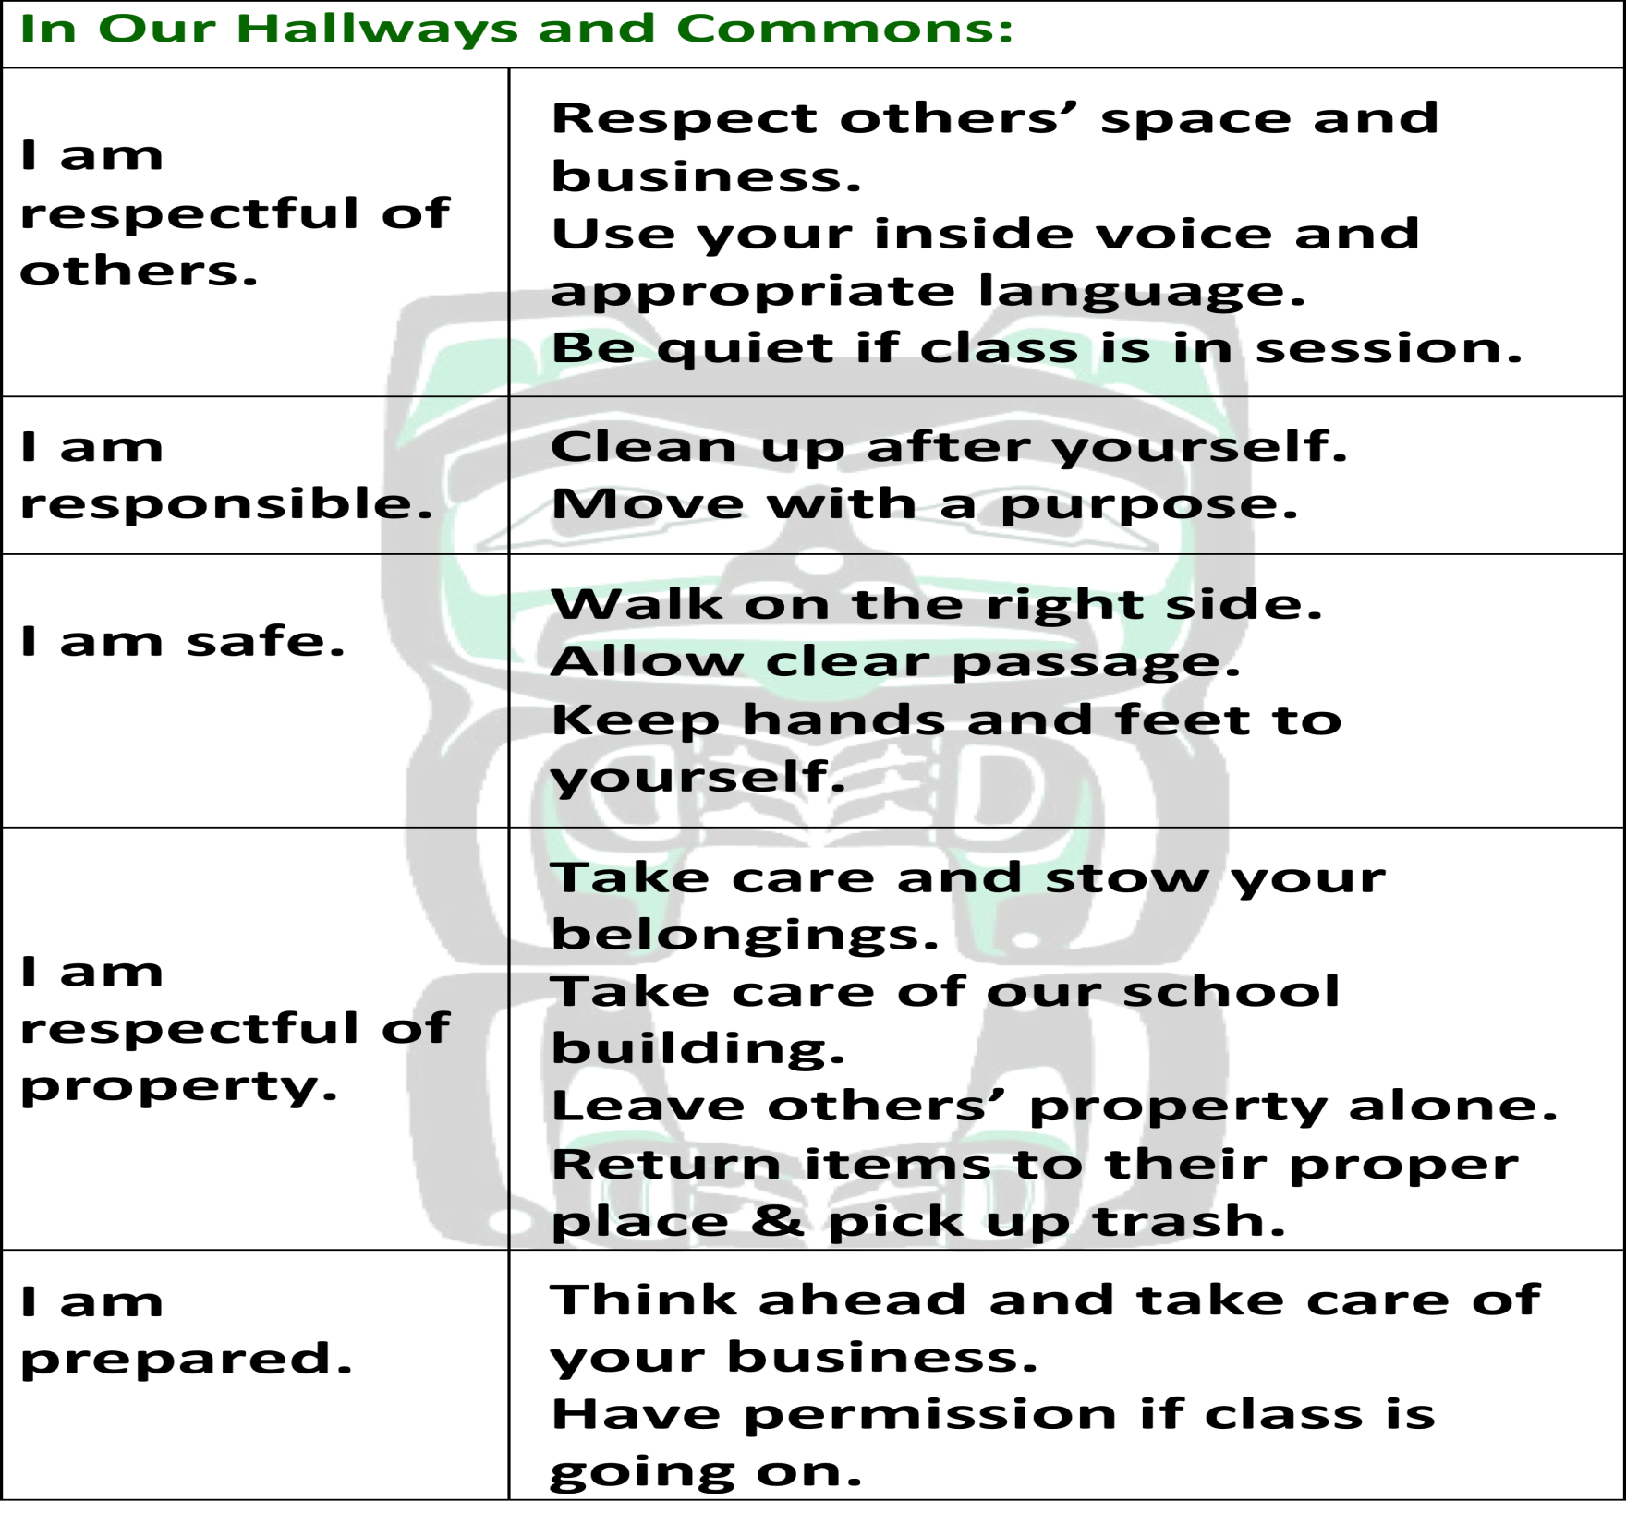
Notes:
Insert your schools matrix here

Slide 29
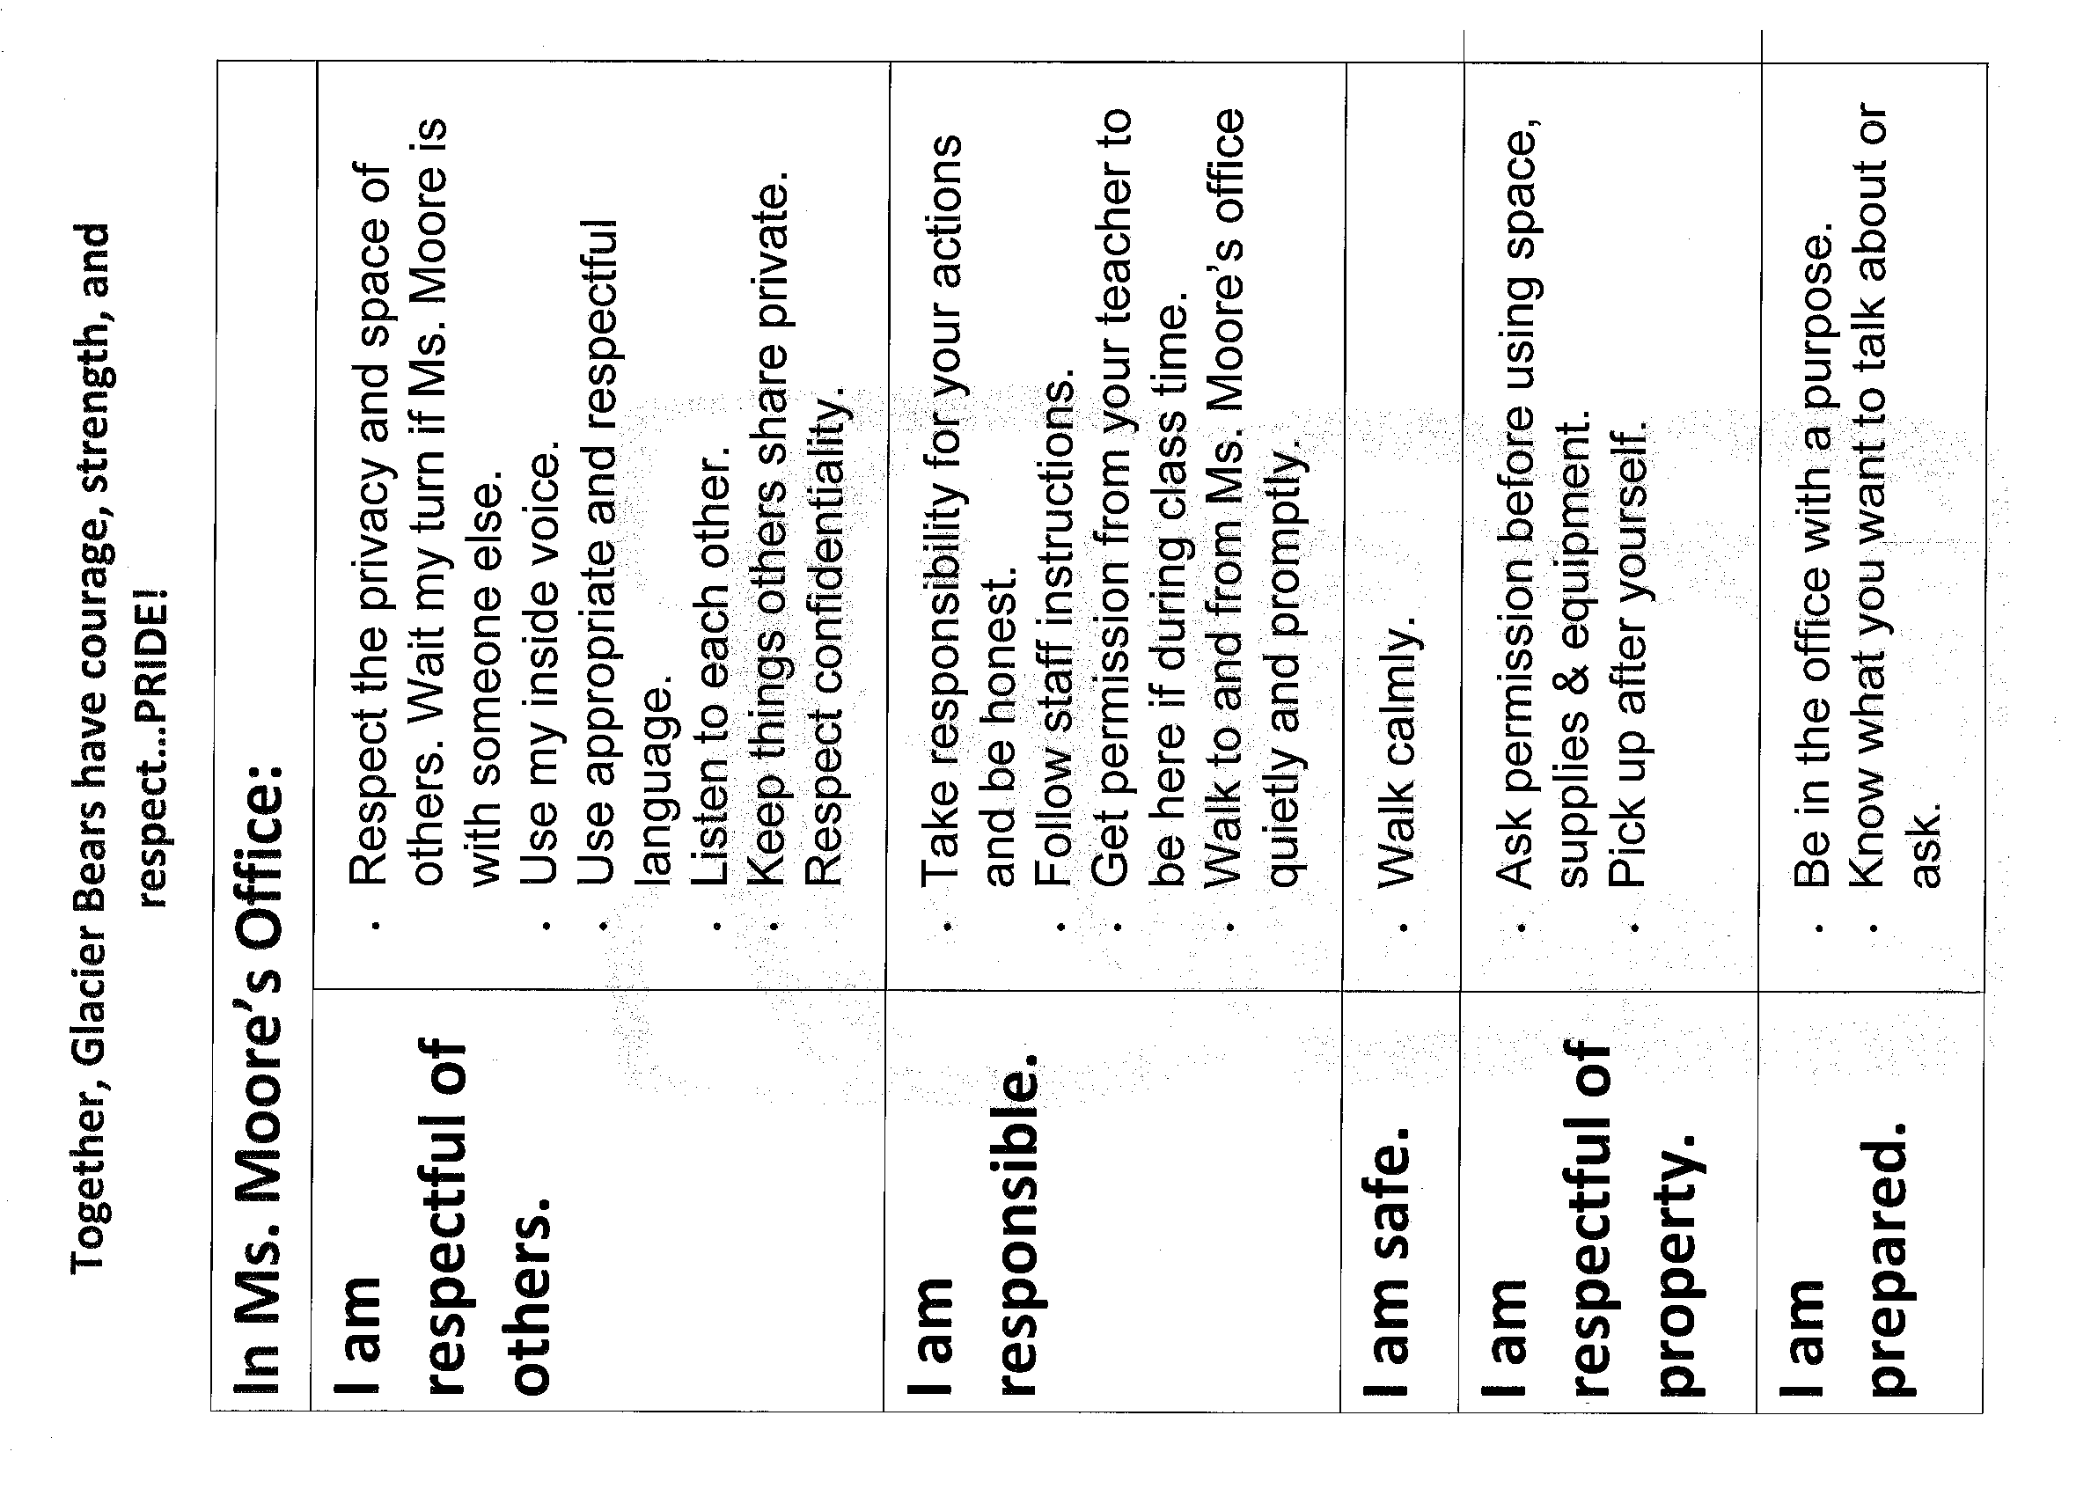
Notes:
This is a sample of what a matrix might look like in a counseling office setting.

Slide 30
Discussion
Where does PBIS fit into your Agency culture?
Notes:
5 to 10 minute group discussion to begin action planning on how SW-PBIS will be implemented in your agency’s culture.

Slide 31
Tier 1-Steps 4 & 5: Teaching Behavior Expectations
How can behavioral health agencies reinforce teaching of the school wide expectations/ school rules?

Slide 32
Sample lesson plan
Notes:
For additional lesson plan samples go to http://education.alaska.gov/tls/swpbs/tiers.html

Slide 33
How does teaching behavior expectations fit into your work with clients?
Notes:
5 to 10 minute discussion on how behavior expectations and teaching of those expectations fit into treatment planning.

Slide 34
What behavioral health initiatives or grants does your agency have that fit with SW-PBIS?

Slide 35
Education of Parents & Community
Parenting with Love & Logic or Love & Limits
Suicide Awareness, Prevention & Postvention activities
  Safe TALK, AK Gatekeeper, ASISIT
Mental Health First Aid training
Transition to Independence TIP training
Bully Prevention
Cognitive therapy
Anger management
Tobacco Alcohol Drug abuse programs
Notes:
Kelly

Slide 36
Discussion
In what ways do PBIS and other agency projects work together?
Notes:
5 to 10 minute discussion

Slide 37
Tier 1-Step 6: Encouraging Positive Behavior Expectations
How can your agency support the school wide PBIS reinforcement system?

Slide 38
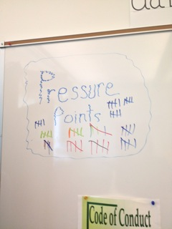
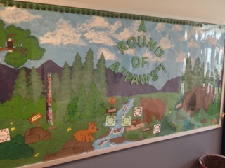
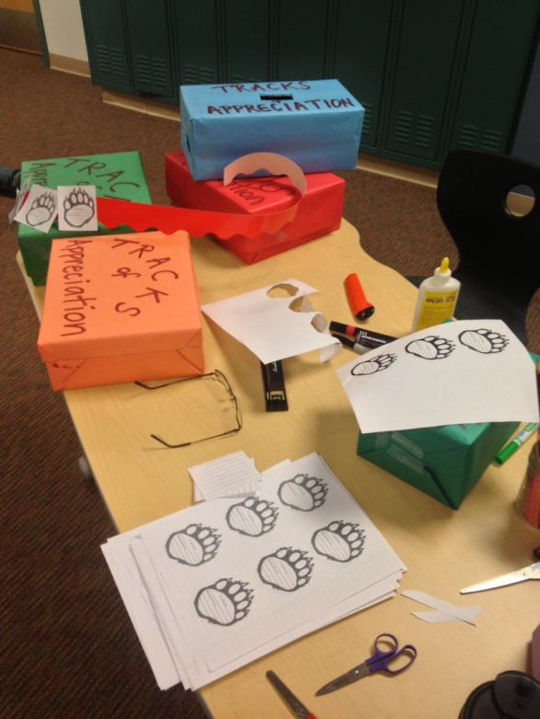
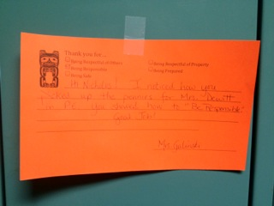
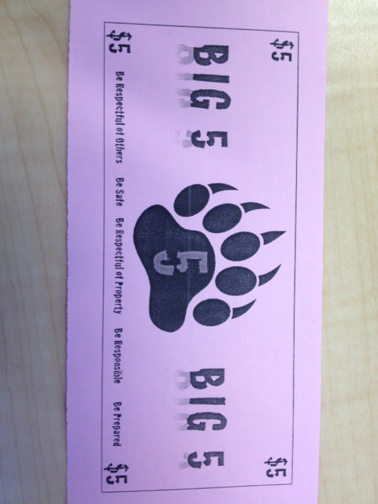
Set up School-wide Reward Systems
Notes:
Sample reward system pictures…… what do the PBIS reward systems look like in your school please insert your own artifacts

Slide 39
Discussion
How can behavioral health agencies support and implement the the reward systems?
Notes:
5 to 10 minute discussion on how your agency can implement /replicate the school based PBIS reward system in the agency and how can your agency staff can implement the reward system when in the school building.

Slide 40
Tier 1-Step 7: Discouraging Rule Violations
How can the consistent violation system help your clients?

Slide 41
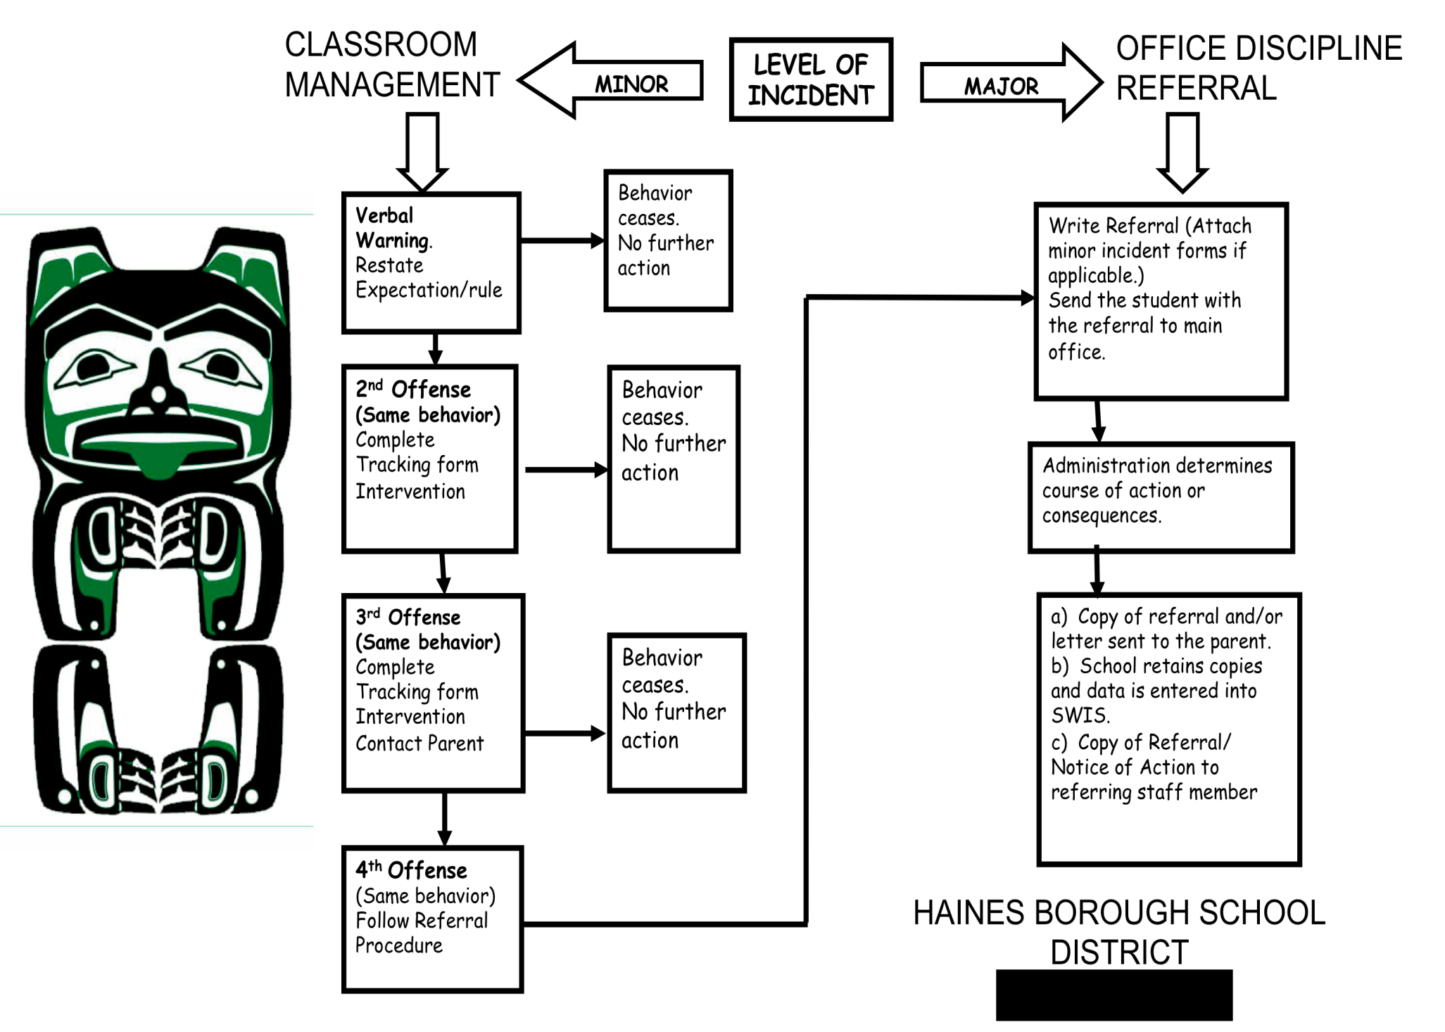
Clearly outlined process for all to follow.
Notes:
Sample please insert your schools behavior flow chart here

Slide 42
Clearly (operationally defined) behaviors.

Slide 43
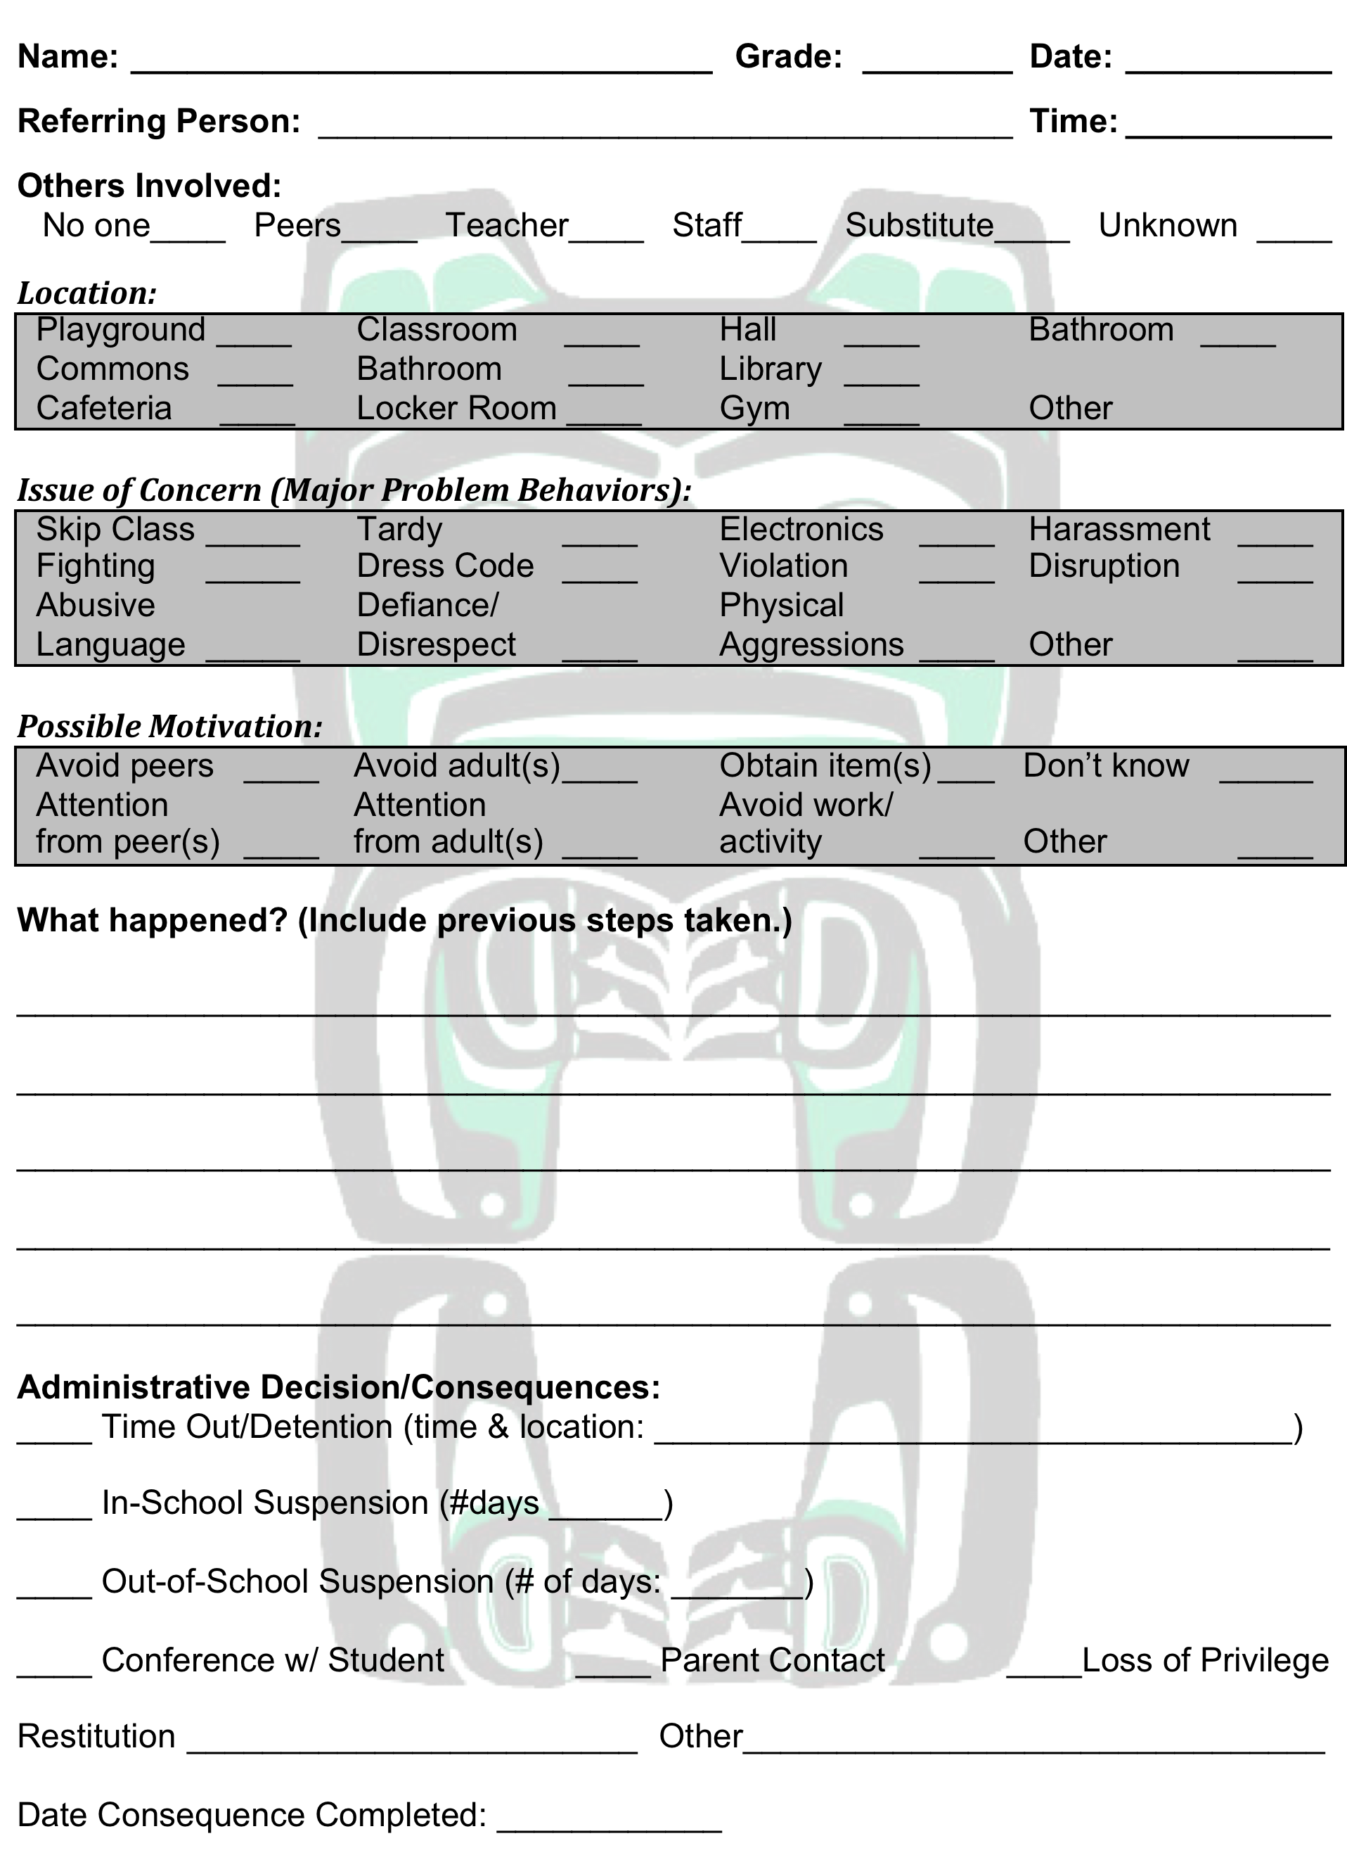
Consistent Office Discipline Referral Form.
Notes:
Please insert your schools office discipline referral form

Slide 44
Tier 1-step 8: Data-based Decision Making and Evaluation
How can the consistent data collection process help students reach YOUR treatment goals?

Slide 45
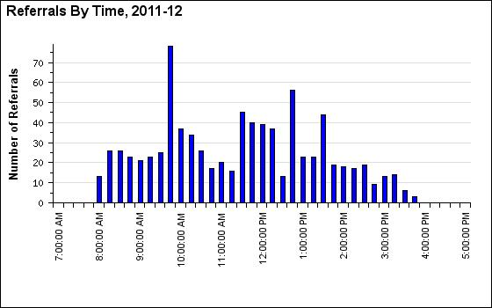
Data collection system established and in use.
For demo go to www.SWIS.org.
Notes:
sample

Slide 46
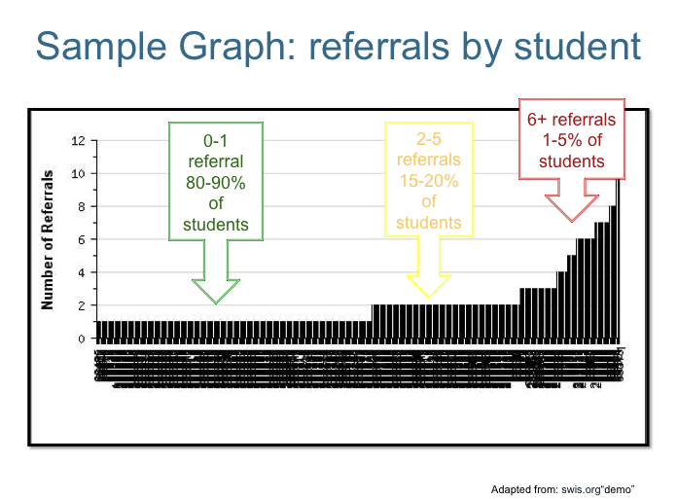
Notes:
sample

Slide 47
5 Key Components to Data Based Decision Making in school and treatment
Average number of referrals per day
Location of incident
Time of incident
Behavior that occurred
Student name
www.swis.org
Notes:
How might these relate to your clients treatment plans?

Slide 48
Discussion
How can this violation system data be used to support your treatment decisions?
Notes:
5 to 10 minute discussion on….. How might these relate to your clients treatment plans?

Slide 49
Questions?
Notes:
kelly

Slide 50
Contact Information:
Please place you information here

